Slide 1
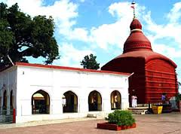
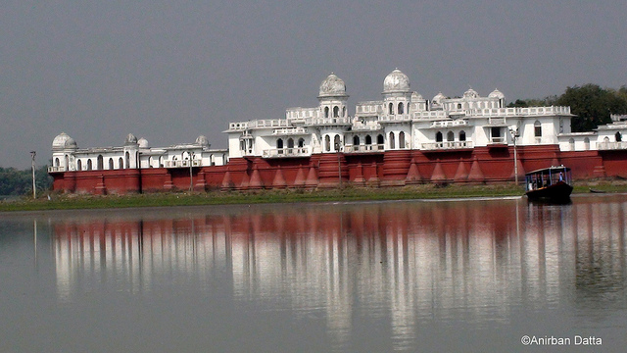
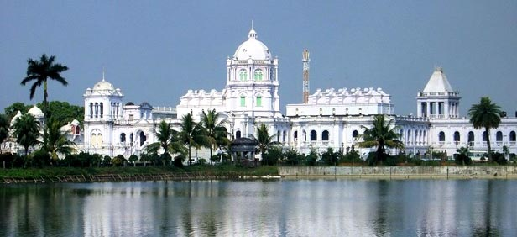
Community Action For Health
TRIPURA

Slide 2
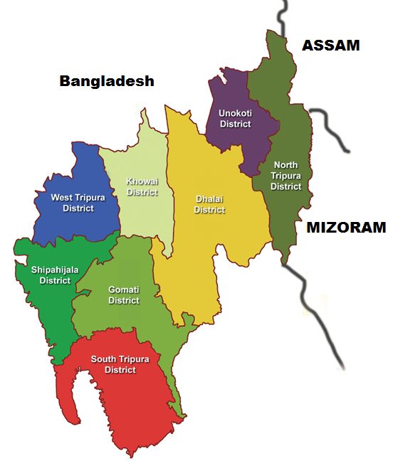
Demography
SL | Item | Number
1 | Population | 36.73 Lakhs
2 | Area Sq. Km | 10486
3 | Density/km2 | 350
4 | Sex Ratio | 961
5 | Literacy | 87.75%
6 | District | 08
7 | Sub-Division | 23
8 | Block | 58
9 | GP & Autonomous Vill. | 1121

Slide 3
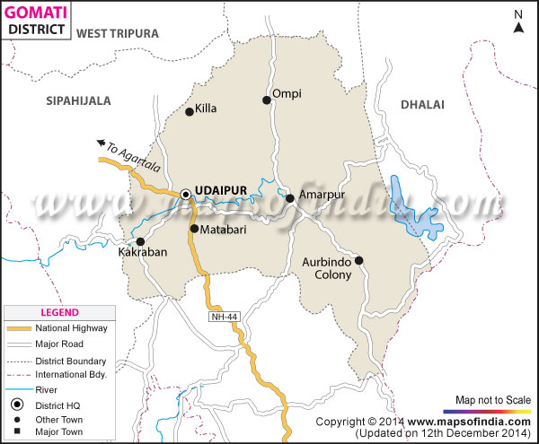
Gomati District
Number of Blocks to be covered: 02
Name of Blocks: Killa Block and Matabari Block
Name of Health Facility to be covered:
Killa PHC and Maharani PHC
Number of GP/ADC to be covered: 15
Number of VHSNC – 15
Number of RKS - 02
Killa PHC :ASHA – 73 / Facilitator -04
Maharani PHC : ASHA – 52 / Faciliator - 03

Slide 4
Status of Implementation of CAH till 31st January, 2016
Sl. | Essential Components | Level of Implementation | Whether Formed/ Conducted | Responsible
Formation of Nodal Agency/Committees
1 | Selection of State Nodal Agency | State level | Yes |  | State ASHA Resource Centre
2 | Selection of District Nodal Agency | District Level | Yes |  | District ASHA Resource Centre
3 | Selection of Block Nodal Agency | Block Level | No |  | District ASHA Resource Centre
4 | Advisory Group for Community Action at State Level | State Level | Yes |  | State ASHA Mentoring Group will act as AGCA (But modification of members yet to be done)
5 | Formation of Planning and Monitoring Committee at Facility, Block level | State/ District. Block/ Facility Level | No |  | District ASHA Resource Centre
6 | Village Health, Sanitation & Nutrition Committee in place | Village Level | Yes |  | District ASHA Resource Centre

Slide 5
Status of Implementation of CAH till 31st January, 2016
Sl. | Essential Components | Level of Implementation | Whether Conducted | Responsible
7 | Visioning Workshop at State Level | State Level | No | State ASHA Resource Centre
8 | Capacity Development Training of Committee Members, VHSNC Members | District Level | Training to PRI members of RKS and VHSNC is an ongoing approved activity at District level under PRI initiative. | District ASHA Resource Centre
9 | Capacity Development of PRI, journalists, civil society, NGO members etc. | District Level | No | District ASHA Resource Centre
10 | Preparation of report card on the basis of MIS report | District Level | No | District ASHA Resource Centre
11 | Public Dialogues (Jan Sunwai) in village level | District Level | No | District ASHA Resource Centre

Slide 6
Community Process...The Journey
Active Participation of PRI
ASHAs are selected and accountable to PRI
112 ASHAs as PRI Member and 19 as Pradhan
VHSNCs are in place and having joint Bank A/C
VHSNC expenditure includes Sanitation, cleaning, referral, local awareness, other local need based activities.
Rogi Kalyan Samity – Regular meeting and expenditure above 76%
Training of VHSNC members and RKS Member carried out for One Day
Special Support Structure for ASHAs at CHC/ PHC level
ASHA Varosha Divas – at Facility level
Incentivization @ Rs. 20,000/- for best performing GP/ADC under each facility (PHC/CHC/SDH). Concerned GP/ADC have to achieve more than 95 % achievement in three areas out of four. Areas are namely Inst. Delivery/Full Immunization/Full ANC & HBNC
District Specific Effort (Gomati District): Convergence Meeting at
--- GP Level i.e HSC ( within 1st to 10th day of every month)
--- CHC/PHC/SDH level (within 11th to 20th day of every month)
--- District level (within 21st to 30th day of every month)

Slide 7
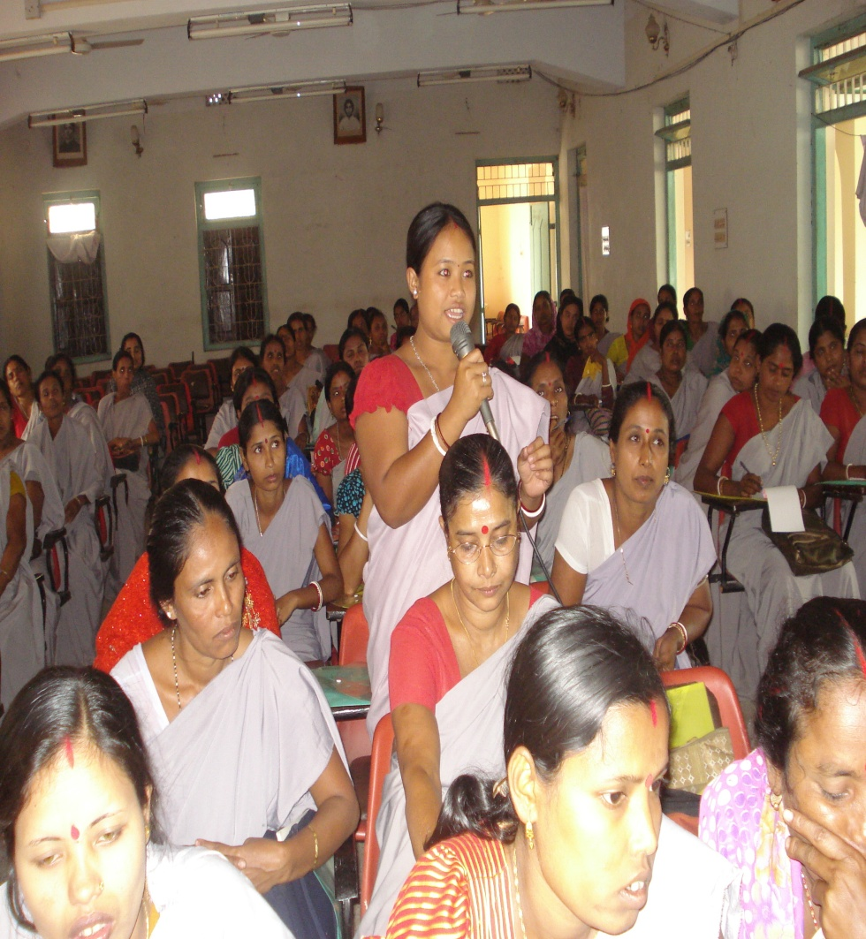
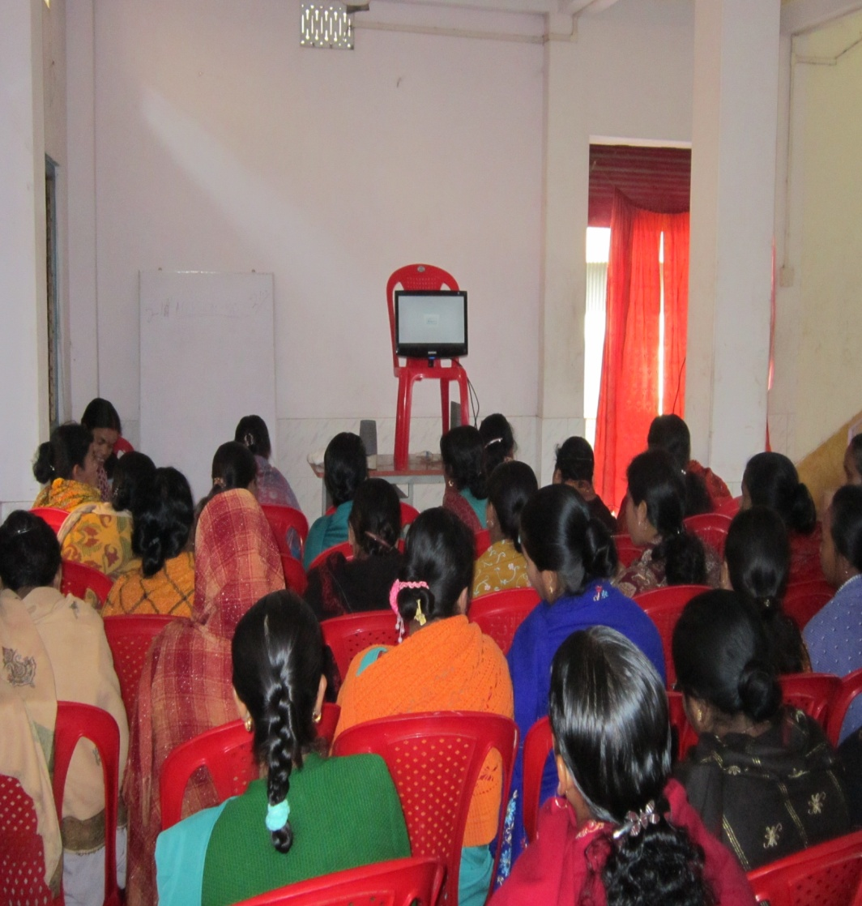
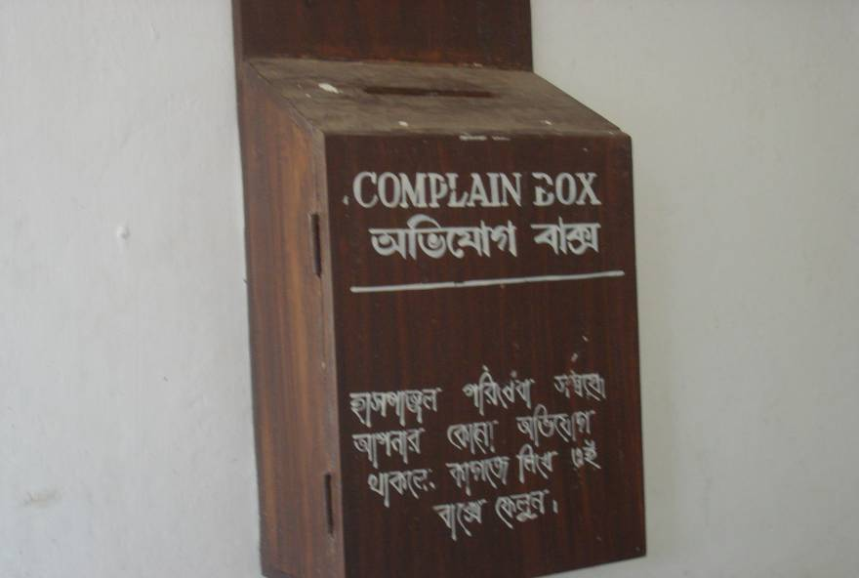
Community Process – Through the Lenses

Slide 8
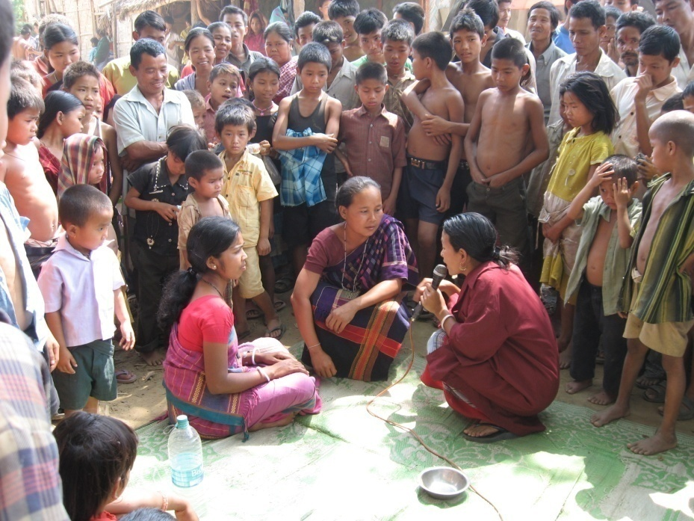
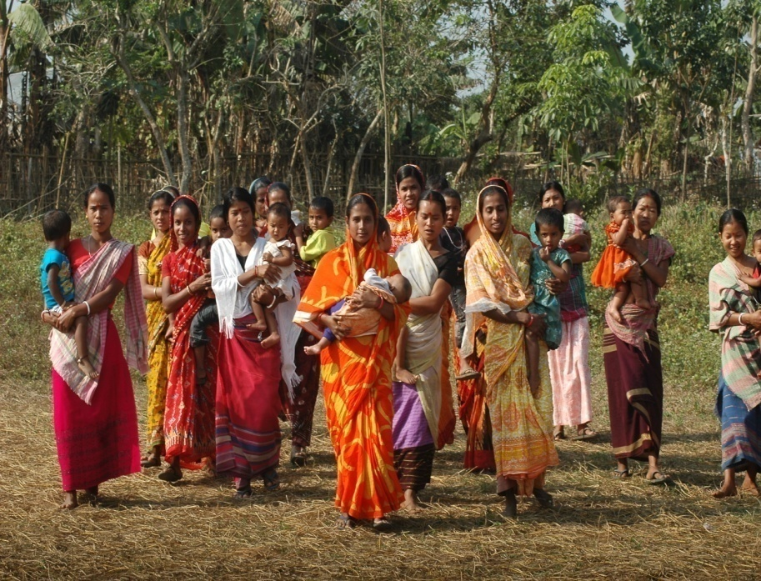
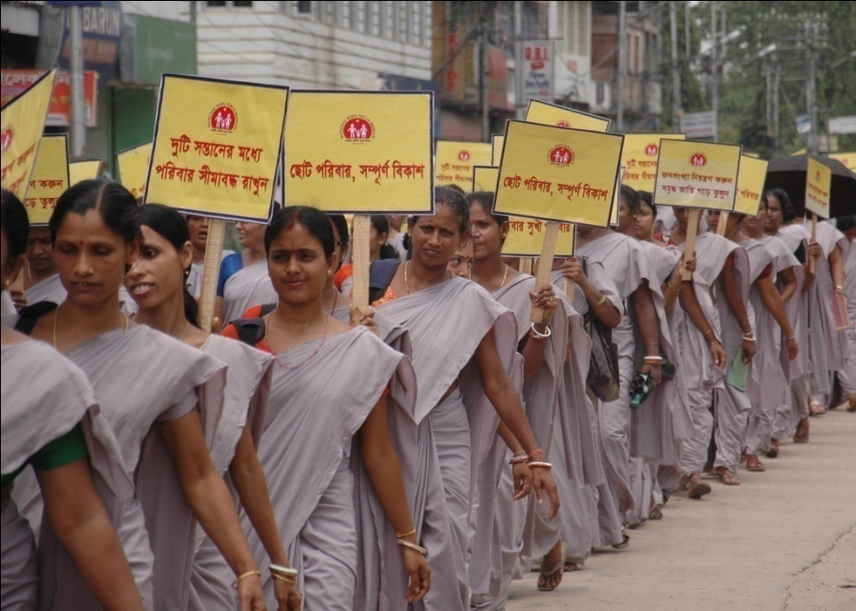
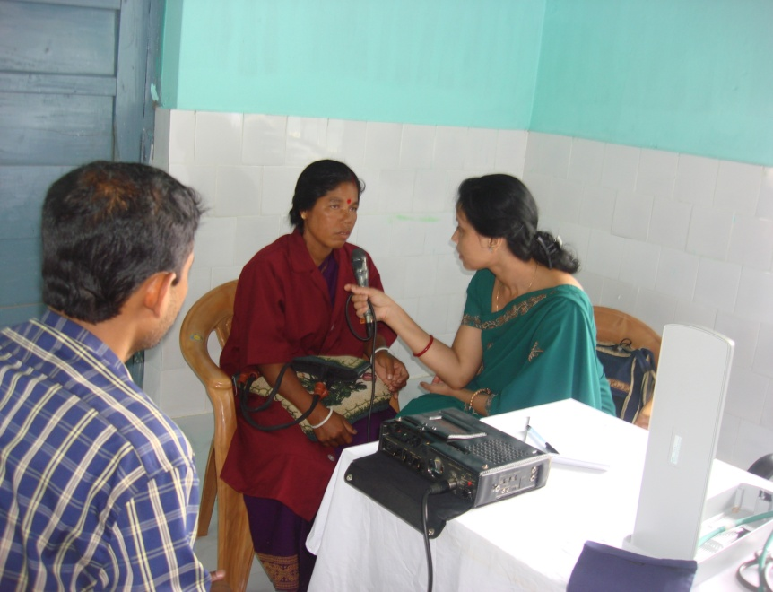

Slide 9
Bottlenecks
Policy Decision at State Level reg Initiation of CAH - Shifting of Pilot District from Dhalai (HPD) to Gomati District
Priority / Focus on CAH Component

Slide 10
Way Forward
Particular | Plan for Implementation
State AGCA | State AMG will act as AGCA for CAH. Members of AGCA to be modified.
State level Visioning Workshop | State ASHA Resource Centre shall organize Visioning Workshop as per CBPM Guidelines – March 2016
District | One day District level Workshop of the pilot districts proposed to be organized involving key district health officials, PRI members and CBOs by the District PMSU & District Mentoring Team.
Block | Block Planning & Monitoring Committees will be formed. One day Block Providers Workshop by District & Sub-division PMSU.
State TOT for VHSNC | March, 2016 at Agartala
PHC | Training of VHSNC Members after State TOT

Slide 11
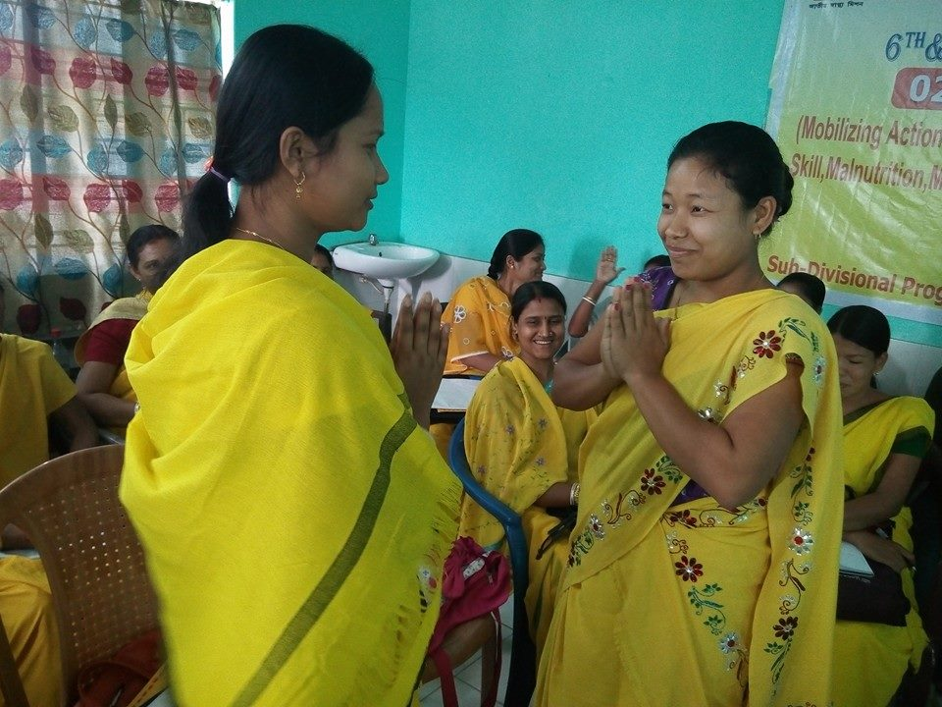
Thank You

