Slide 1
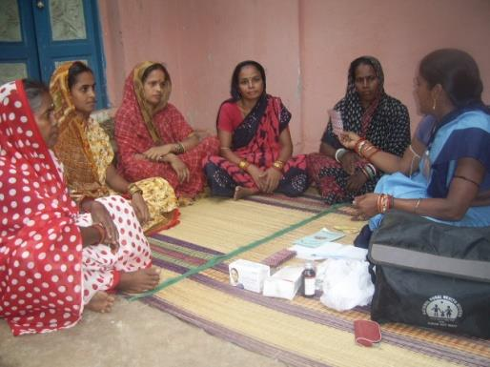
Community Based Approaches in the National Health Mission: Lessons and Challenges
Dr Rajani Ved
National Health Systems Resource Centre

Slide 2
India’s National Health Mission: An Architectural Correction of the Health System
Vision: “Attainment of universal access to equitable, affordable and quality health care, which is accountable and responsive to the needs of the people”
NHM-Core Strategies
Community Processes
Flexible Financing
Monitoring Progress Against Standards
Innovation in Human Resource Management
Expanding service delivery and entitlements towards UHC

Slide 3
Principles of Community Based Approaches
Health systems strengthening requires community participation as an integral component
Health system reform: not just about finances, structures, systems, and technology but requires software as well
People are not patients, clients, users, beneficiaries but active participants of the system.

Slide 4
Community Based Approaches in NHM
Expanding service coverage: through a range of mechanisms - ASHA, expanded outreach, (VHND/UHND) strengthening first point of care, active reach to marginalized – enabling equity
Creating frontline worker teams – ASHA , AWW and ANM: linking the community with the health system; introducing Team Based Incentives
Citizen empowerment to take charge of their own health: ASHA, VHSNC, MAS including membership of SHGs
Increasing quality of services by building accountability using community and facility based committees: VHSNC, MAS, CAH
Mobilization and demand generation : Incremental movement: achieving universal coverage for reproductive and child health services

Slide 5
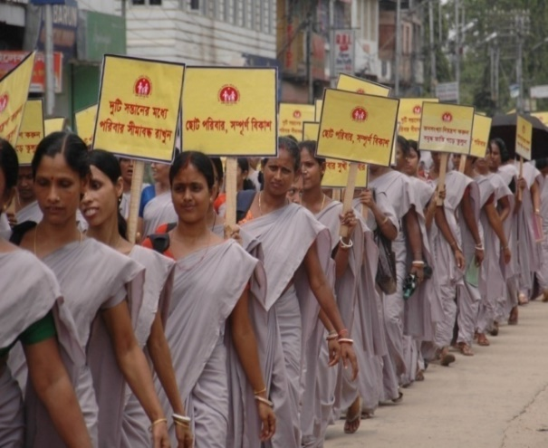
Key elements of community processes in NHM
ASHA – community health worker; local, community based selection
Village Health Sanitation and Nutrition Committee (VHSNC) and Mahila Arogya Samities
Over 500,000 VHSNCs across the country ( GP/Revenue village level) and nearly 70,000 MAS in urban areas
Key platform for social determinants and convergence at village level
Provision of untied funds

Slide 6
Key elements of community processes in NHM
District Health Societies as avenues for public participation in planning, monitoring. and decision making.
Community Action for Health: largely civil society led
Community awareness on health entitlements
Community led data collection,
Periodic sharing of report cards, community experiences of health service
NGOs and other civil society organizations to support the implementation of these components.

Slide 7
ASHA-(urban and rural) 8,60,000
Skill building
Blended Payments: Fixed and Task Based Incentives
Equipment/ Drug Kits
Support /Training structure
Career Opportunities
Grievance Redressal
Notes:
-

Slide 8
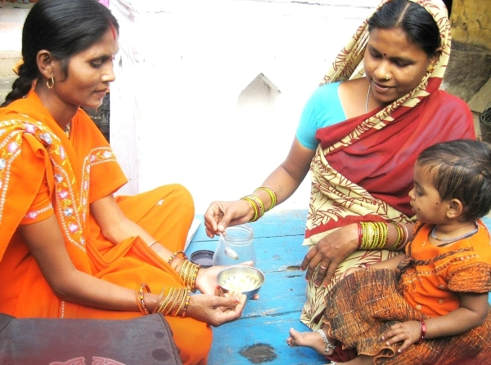
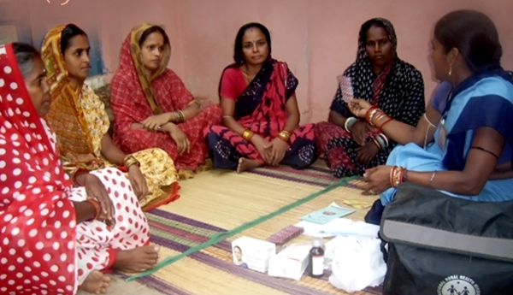
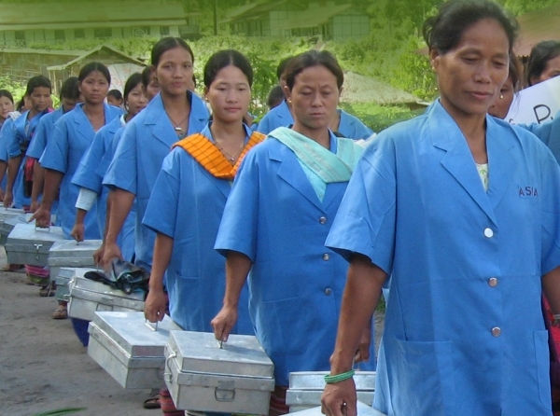
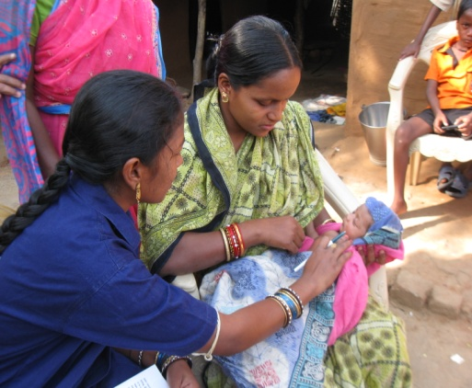
Three roles : Facilitator, mobilizer/activist, and community level care provider

Slide 9
Support Structures
State
MD, NRHM
State ASHA Mentoring Group
District
District Community Mobilizer – part of District Programme Management Unit
Block
Block Community Mobilizer- part of Block Programme management Unit (100,000 pop)
Community Processes Resource Centre
Sub block
ASHA Facilitator (one per 10-20 ASHA)/
Village Health Sanitation and Nutrition Committees (VHSNC)
ANM
State Trainers
District Trainers

Slide 10
Support Systems
83% of district community mobilizers, 85% of Block community mobilizers, and 94% of ASHA facilitators are in place
Over 95% of VHSNC are in place and 90% have bank accounts
MAS in urban areas: only 48% in India- 905 In NE states; 60% in High focus states and about 42% in non high focus states.

Slide 11
Village Health, Sanitation, and Nutrition Committees
Over 500,000 across all states.
At revenue village / GP level – (varies across states)
Untied fund of Rs. 10,000 per year per VHSNC
Envisaged roles as ‘platform for community action’ –
- provide information to community,
- ensure convergent action on social determinants,
- serve as a platform for community action,
- support health providers,
- empower Panchayats for a role in health
Minimum 15 members, 50% female representation , ASHA – member secretary;
Minutes of Monthly Meetings, Annual expenditure to be submitted before Gram Sabha, & UC to be issued by GP

Slide 12
Rogi Kalyan Samitis (RKS)
Formed at all levels of facilities – district, block and sub-block (DH, SDH, CHC & PHC, and in untied funds accounts of SC)
PRI representation : RKS guidelines revised in 2015, include ZP Chairperson block panchayat members
To ensure greater convergence with outreach services, VHSNCs/GPs are also represented in the RKS, on rotation basis.

Slide 13
Public Services Monitoring Tool: integral part of training of VHSNC/MAS
Anganwadi Centres
Complementary Feeding
Mid-Day Meal Scheme
Health Services
Food Security
Education
Hand Pump
Individual/Household Latrines
Others: Violence; Early Marriages

Slide 14
ASHA: Progress to Date
ASHA plays an important role in improving health seeking behaviours and improved care seeking for institutional delivery, newborn and child health and nutrition, malaria and TB. (varies across contexts) .
Local community based selection, experiential training in a set of specific competencies and skills and a field based, hands-on mentoring and supportive supervisory mechanism.
Performance Based Incentives for a range of tasks- streamlining of payments and far fewer delays- helped by Direct bank transfers
Socio Demographic/local context changes necessitate newer roles: Non communicable diseases, palliative care, first responders in disaster situations.
ASHA certification: A step towards ensuring quality of community based services and improving confidence and self esteem
Part of Primary Health Care team: Role in Health and Wellness Centres
Pivotal role in supporting disease support groups for NCD self- care and treatment adherence.

Slide 15
Experiences with PRI Engagement
Most states have undertaken basic orientation (one or two days duration) for VHSNC members at the block/PHC level, but PRI participation low.
Level of PRI engagement in Community Processes interventions is mixed- notable exceptions : Chhattisgarh, (Swasthya Panchayat Yojana) Odisha (Gaon Kalyan Samities, Kerala (Ward Panchayats- undertaking palliative care/action on GBV)
Cause of death analysis in VHSNC: useful beginning to establishing understanding of mortality
Issues of mis/non use of untied funds
PRI in RKS is limited – challenges on both sides

Slide 16
Public Platforms: Challenges
Slow progress in strengthening committees and monitoring use of untied funds
Role in community based planning and monitoring limited unless facilitated by civil society networks or ASHA support system
Constitution of committee- variable, lack of clarity in guidelines
Defining the relationship of the ASHA to the VHSNC – leader, member, convener, or bystander?
Defining the relationship of the VHSNC to the GP and to the village and hamlet
Ensuring representation of the marginalized/women

Slide 17
Public Platforms: Challenges
No well defined mechanism for support, training at any level
Use of untied funds?- “mandated” spend, issues with signatories, delayed fund flows
Community monitoring committees were/are not the VHSNC
Regularity of meetings, Record keeping, action plans- little understanding of programme managers and service providers
Urban ASHA and MAS formation and creation of support mechanisms – needs review of design: Jan Arogya Samities?

Slide 18
Public Platforms: Challenges
Institutionalizing systems for training, support and payments.
Managing Turnover and Renewal in VHSNC/MAS members
Unexplored role of IT to address scale: in capacity building/supervising
Retaining community embeddedness of ASHA
Strengthening linkages with PRI/ULB

Slide 19
Opportunities
Enabling intersectoral action through convergence with PRI and other sectors: VISHWAS - -with SBM
Increasing focus on Comprehensive Primary Health Care: strong linkage with Community Health Systems
Use of public platforms in Swasth Nagrik Abhiyan- a social movement for health
Mission Antyodaya: Poverty Free Gram Panchayats
NHP, 2017: “coordinated action on seven priority areas for improving the environment for health with measurable achievements through well thought out and financed institutional mechanisms”.
Swachch Bharat Abhiyaan,
Balanced and Healthy Diets,
Addressing Tobacco, Alcohol and Substance Abuse,
Nirbhaya Nari,
Yatri Suraksha,
Reduced stress and improved safety in the work place
Reduced indoor and outdoor air pollution

Slide 20
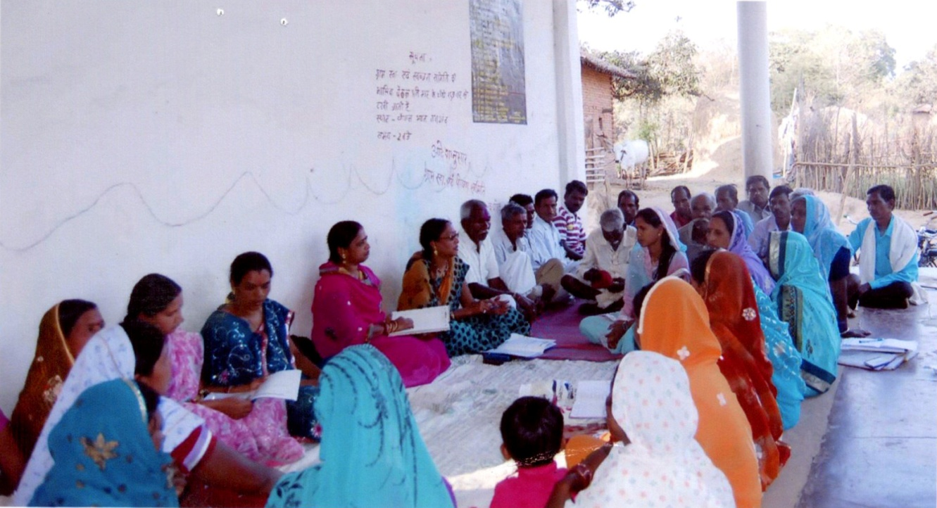
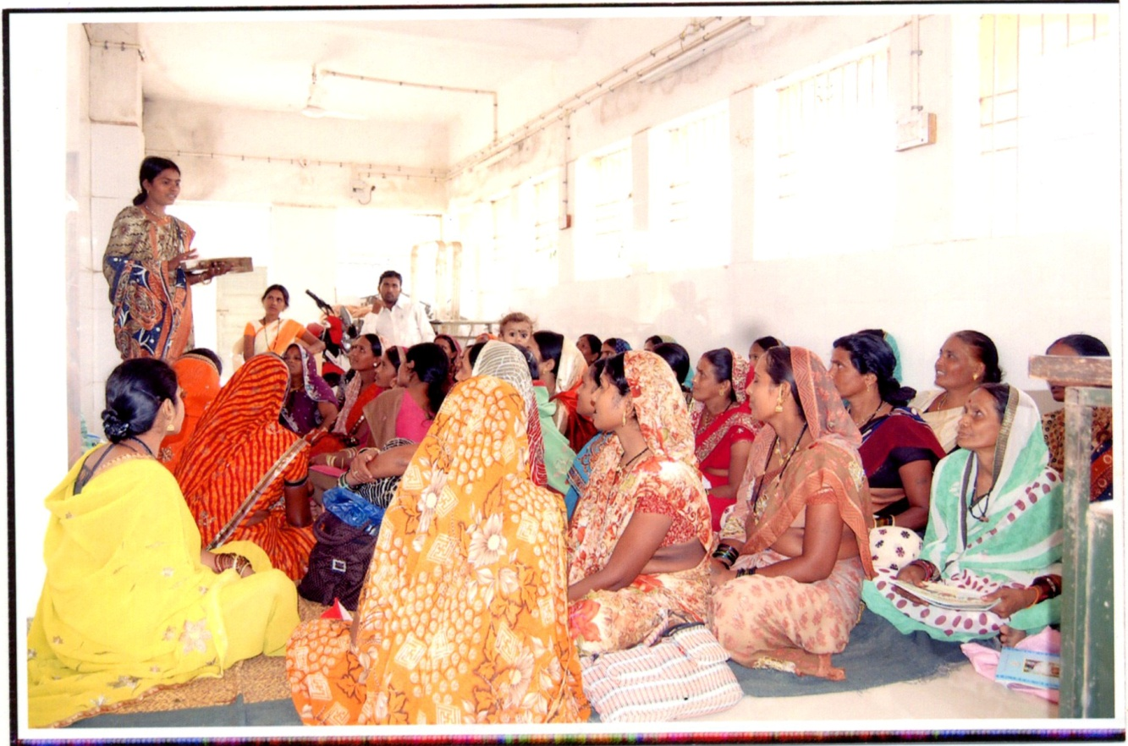
THANK YOU

