Slide 1
National Consultation on Community Action for Health 11th -12th March 2019 H&WCs- Monitoring by VHSNC Members –Assam
Presentation by:
Dr. Pranjal Tamuli – SPO, NCD, NHM Assam
Mr. Partha Saikia – State Community Mobilizer, NHM Assam

Slide 2
Comprehensive Primary Health Care(CPHC)
As defined by WHO,- “ Essential Care based on Practical, Scientifically sound and Socially acceptable methods and technology made universally accessible to individuals and families in the community through their full participation and at a cost that the community and the country can afford to maintain at every stage of their development in the spirit of self-reliance and self-determination”

Slide 3
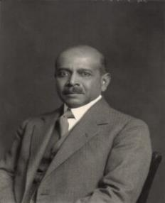
Understanding Evolution of CPHC
Bhore Committee report, 1946
Alma Ata Declaration, 1978
Health for all by 2000
National Health Policy, 1983
Millennium Development Goals
National Health Policy, 2002
National Rural Health Mission, 2005
Sustainable Development Goals
National Health Policy, 2017
Sir Joseph William Bhore

Slide 4
Comprehensive Primary Health Care (CPHC ) through HWC
Continuum of Care – Telehealth /Referral
Infrastructure
Expanded Service Delivery
Community Mobilisation and Health Promotion
Financing/
Provider Payment Reforms
Partnership for Knowledge & Implementation
Robust IT System
Comprehensive Primary Health Care (CPHC )
through
HWC
Medicines & Expanding Diagnostics - point of care & new technologies
Expanding HR - MLHP & Multiskilling

Slide 5
CPHC - Essential Package of Services
Care in Pregnancy and Child-birth.
Neonatal and Infant Health Care Services
Childhood and Adolescent Health Care Services.
Family Planning, Contraceptive Services and other Reproductive Health Care Services
Management of Communicable Diseases: National Health Programmes
General Out-patient Care for Acute Simple Illnesses and Minor Ailments
Screening, Prevention, Control and Management of Non-communicable Diseases
Care for Common Ophthalmic and ENT Problems
Basic Oral Health Care
Elderly and Palliative Health Care Services
Emergency Medical Services including Burns and Trauma
Screening and Basic Management of Mental Health Ailments

Slide 6
Progress in implementation of HWCs- Assam
CATEGORY OF HI | HWC 2018-19 PIP TARGET | HWC NOTIFIED 2018-19 | HWC FUNCTIONAL
SUB CENTRE | 691 | 638 | 306
PRIMARY HEALTH CENTRE | 133 | 316 | 150
URBAN HEALTH CENTRE | 54 | 53 | 48
TOTAL | 878 | 1007 | 504
 | SUB CENTRE | PRIMARY HEALTH CENTRE | URBAN HEALTH CENTRE
COMMUNITY OUTREACH | 509 | 12 | 33
UNIVERSAL NCD SCREENING | 447 | 12 | 32
DISEASE SCREENED | INDIVIDUALS SCREENED
HYPERTENSION | 24,463
DIABETES | 24,211
ORAL CANCER | 21,970
BREAST CANCER | 12,188

Slide 7
CPHC- Biomedical vs Social Model
For attaining CHPC/UHC along with Healthcare delivery System, work needs to be done in following sectors-
Education
Agriculture
Water and Sanitation
Healthy Housing
Social Justice
Respectable employment
Socio-economic status
Human rights
Environment
Gender equality

Slide 8
H&WC MONITORING BY VHSNC MEMBERS
Community Action for Health- Assam

Slide 9
Community Action for Health in Assam
In the Pilot phase, 3 Districts and 9 blocks in 2008-09 were covered with the support of local NGOs.
Second phase (2013-14) - small scale up to 5 districts and 34 blocks covering 5678 VHSNCs with the support of local NGOs.
Third phase of Community Action for health 2016-17 spread over in 105 Blocks covering 4200 VHSNCs. The VHSNC of these districts were trained on the handbook and functioning with the support of Nodal and Zonal NGOs.
In 2017-18, CAH was initiated with State budget for Community awareness via the mechanism of VHSNCs carried out with in house manpower. A MCH tool was developed with AGCA in which the ASHA Supervisors of all 27 districts were trained at district level who in phase manner trained VHSNC members.
In 2018-19 Assam has carried out H&WC Monitoring by VHSNC members under Community Action for Health programme which is covering the 7 aspirational districts in 111 batches covering 222 H&WCs and targeting more than 3000 VHSNC members. The state level Training of trainers is completed on 28th & 29th of December 2018. The trainings at the 7 aspirational districts are being conducted. Re- proposal done in 2019-20 PIP done for 61 batches and approved in the RoP 2019-20.

Slide 10
THE COMMUNITY FEEDBACK FORM
- AN EDUCATIONAL PICTORIAL TOOLKIT FOR ASSESSING THE H&WC

Slide 11
WHAT IS H&WC MONITORING BY VHSNC MEMBERS?
H&WC Monitoring by VHSNC members under Community Action for Health is training the VHSNC members on a feedback form and monitor an H&WCs resources and functionality. The community feedback form is centered towards the community ownership of health services ensuring community participation which also acts as a bi- monthly social audit system. A great opportunity to introduce the services availed by NHM to the community under Ayushman Bharat initiative.
Districts Covered: All 7 aspirational districts.
H&WC assessment: The feedback form is a pictorial toolkit for assessing the availability & functionality of a Health & Wellness Center as well as the community feedback on services.
An educational Tool: The feedback form itself serves as an IEC material.
Districts have rolled out trainings and also assessments of H&WC by VHSNC members are being done. The responses recorded are collected via a H&WC tracker.
The recorded responses are actionable either to be solved locally or higher authority via proper channel.

Slide 12
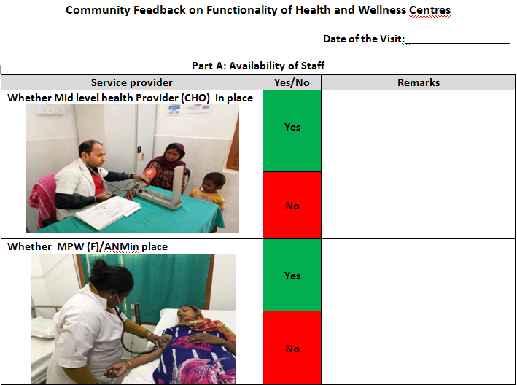
STAFF AVAILABILITY

Slide 13
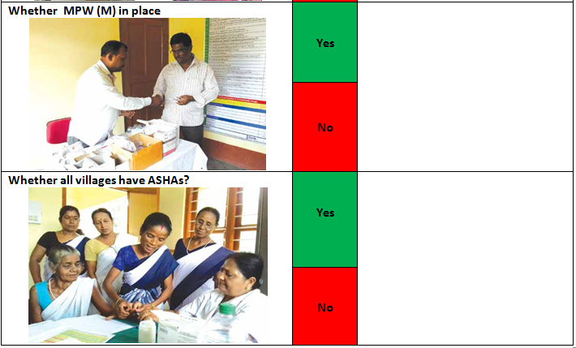
STAFF AVAILABILITY

Slide 14
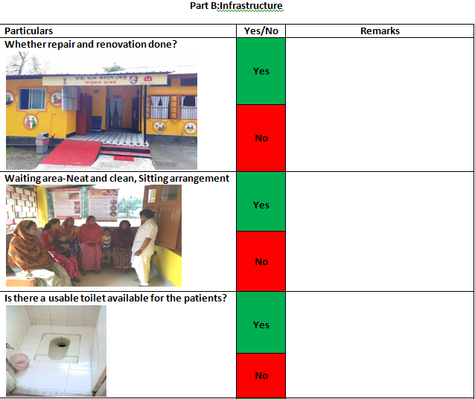
INFRASTRUCTURE

Slide 15
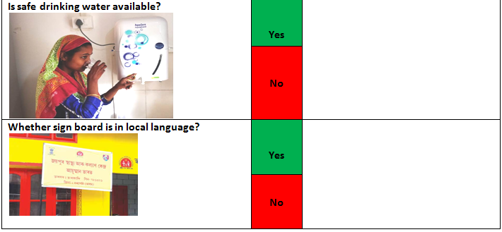
AMENITIES & SIGNAGE

Slide 16
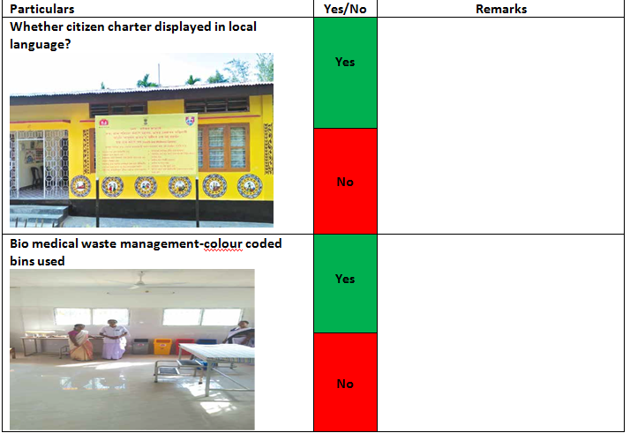
INFRASTRUCTURE

Slide 17
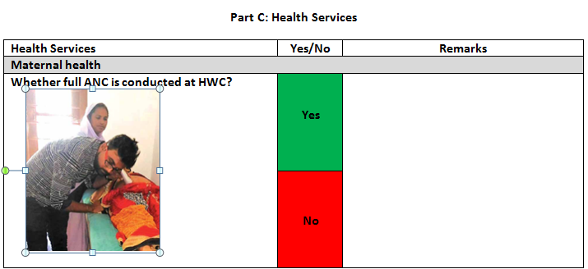
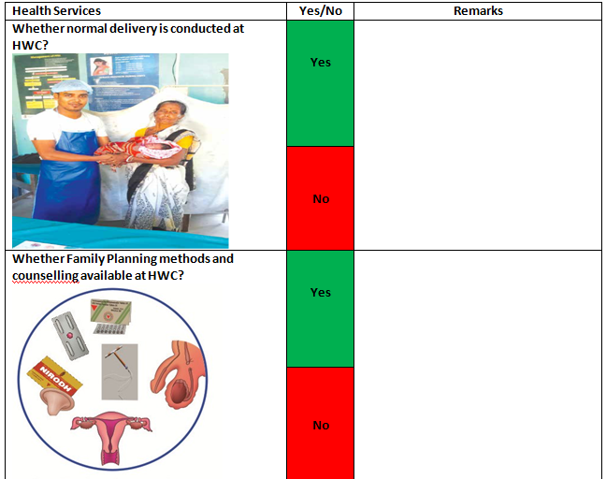
HEALTH SERVICES

Slide 18
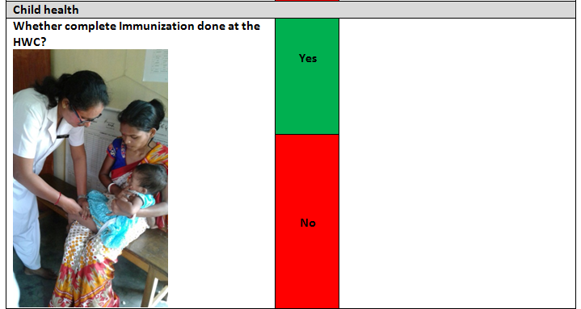
HEALTH SERVICES

Slide 19
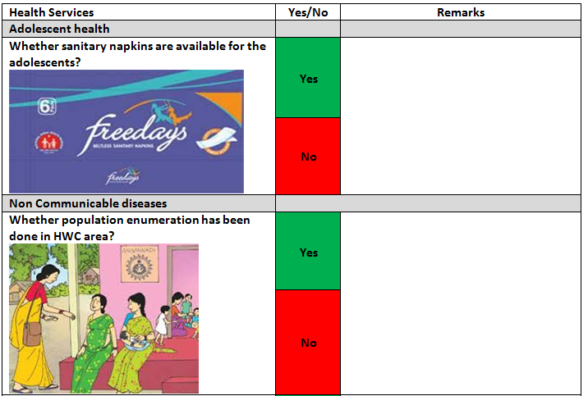
AVAILABILITY OF AMENITIES

Slide 20
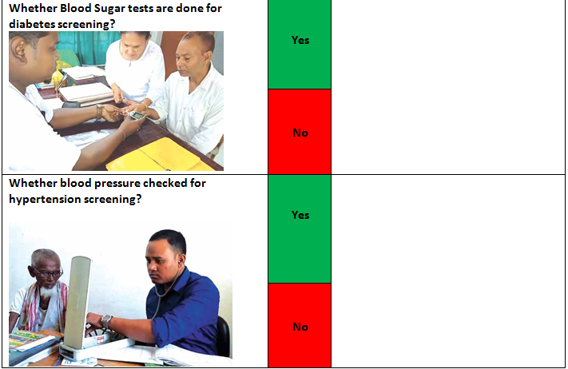
SCREENING OF NCDS

Slide 21
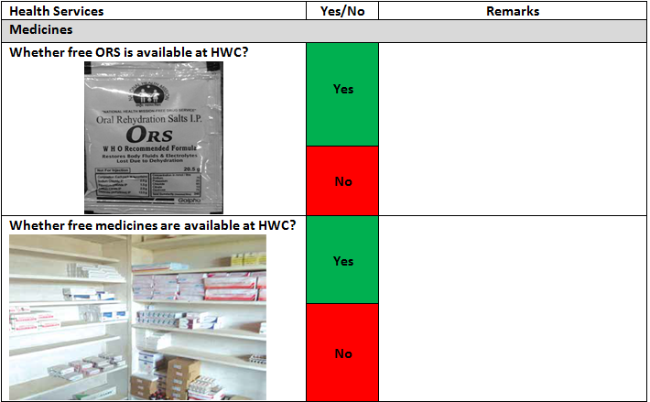
MEDICINE AVAILABILITY

Slide 22
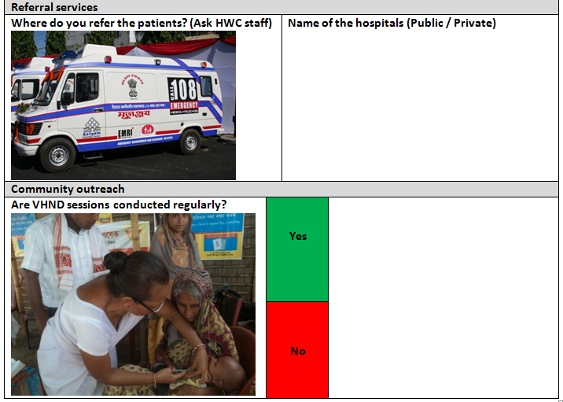
ACCESSIBILITY & COMMUNITY OUTREACH

Slide 23
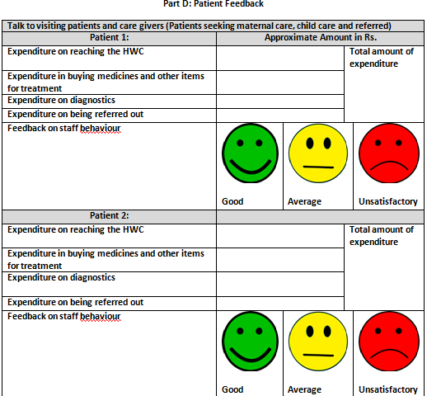
FEEDBACK FROM PATIENTS

Slide 24
DISCUSSIONS WITH CHO ON THE FINDINGS AND FILLING OF GAPS IF ANY
Part E: Discussions with CHO on the findings and filling of gaps if any:
In this part the VHSNC members who will be assessing the HWC will discuss with the CHO on the findings done by the members using the feedback form, request to solve the problem if locally doable otherwise reporting to authority through proper channel.
Part F: Action plan to fill the gap
Gap identified | Solution | Responsibility | By when | Action taken

Slide 25
WHAT ARE THE OUTCOMES?
Bi- Monthly Social Audit by the community.
Community ownership of health services thus making service providers responsible for providing regular un-interrupted services and also sustain quality of services.
A community well informed about the variety of free services available and create demand generation.
Outreach to hard to reach areas. Last mile VHSNC members will be trained so as to ensure coverage.
Help prevent possible out of pocket expenditure.
Problem solving at local level.

Slide 26
RECORDED RESPONSES

Slide 27
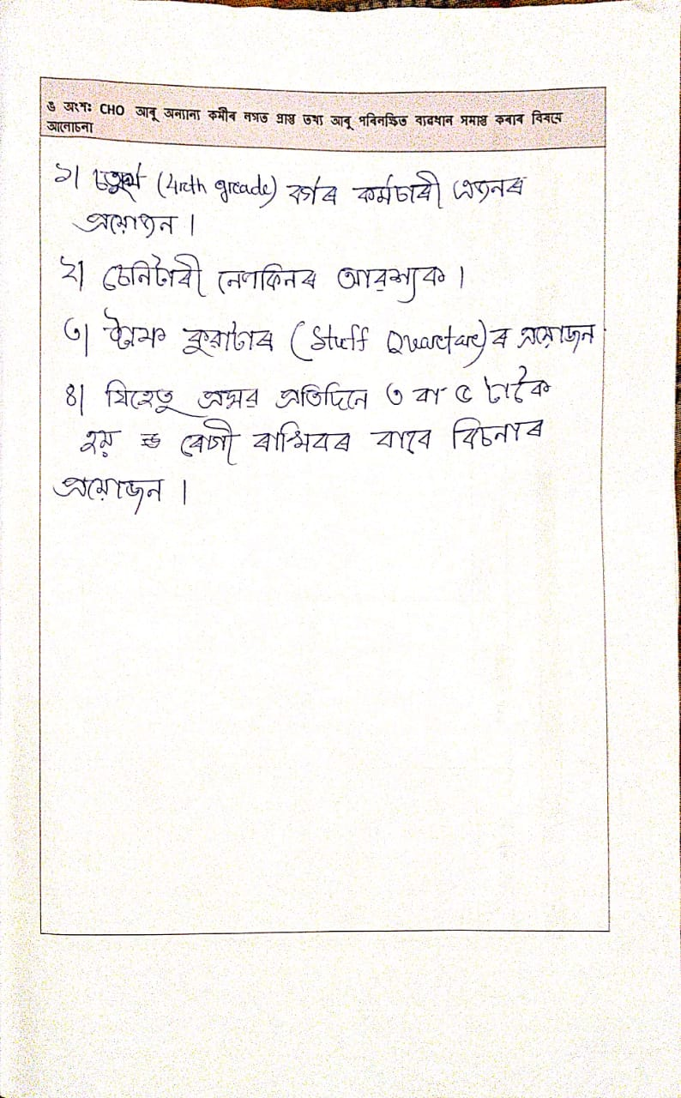
PART E: DISCUSSIONS WITH CHO ON THE FINDINGS AND FILLING OF GAPS IF ANY.
RECORDED RESPONSE
Assessment of an H&WC was done and the part E recorded response as shown which indicates:
Requirement of a Grade IV Staff.
Requirement for sanitary napkins.
Staff quarters required.
Since more than 5 deliveries are conducted in the H&WC additional beds are required for post natal care.

Slide 28
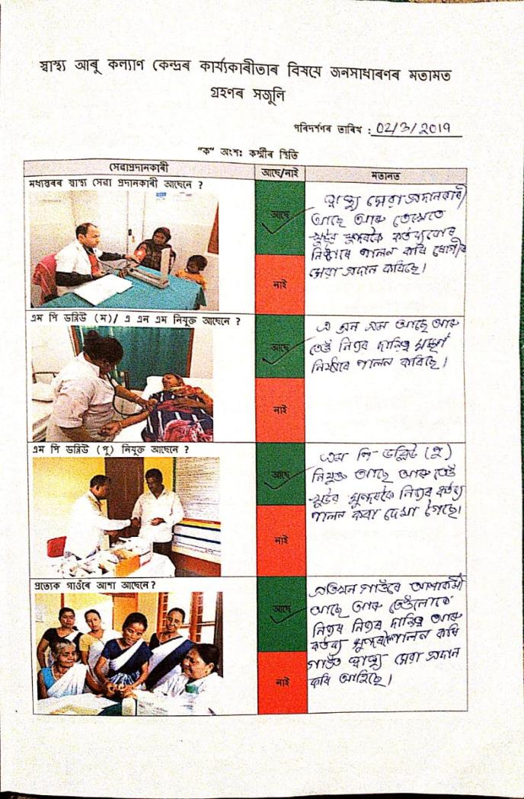
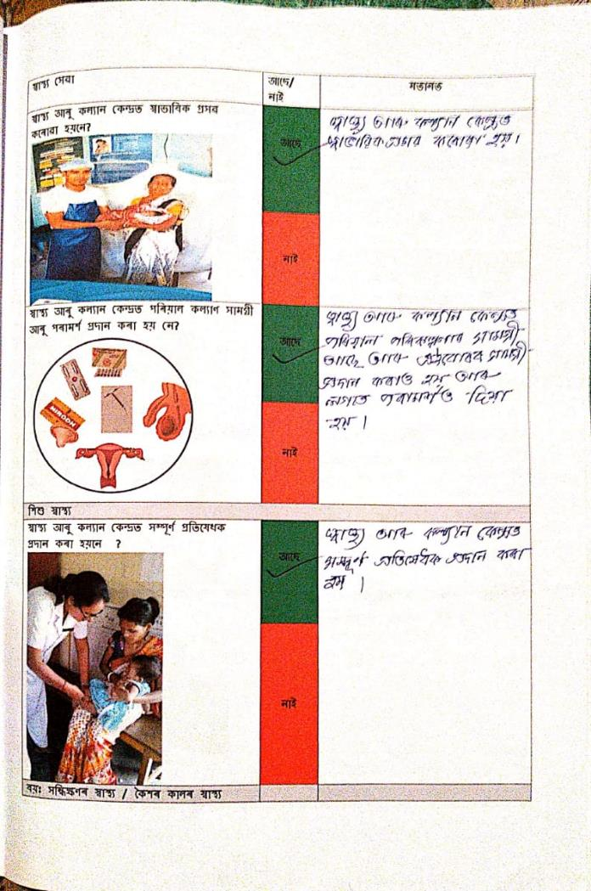
RECORDED RESPONSES

Slide 29
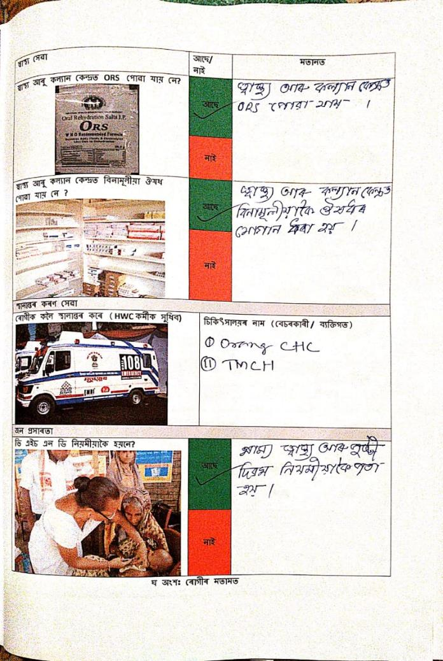
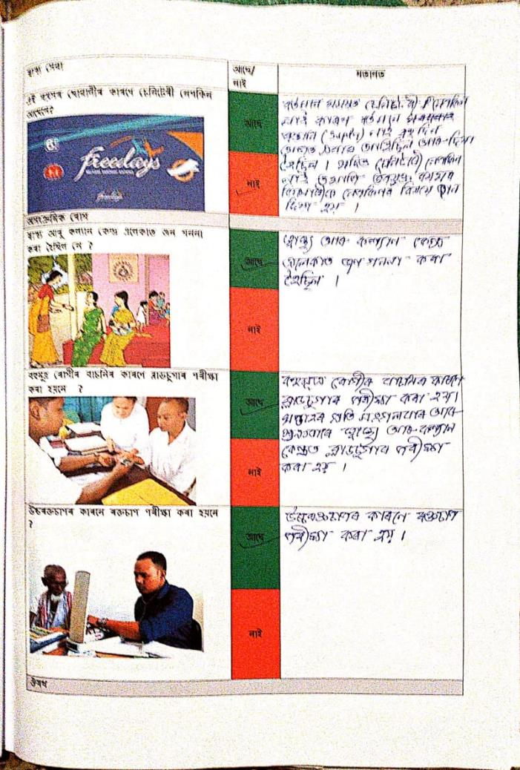
RECORDED RESPONSES

Slide 30
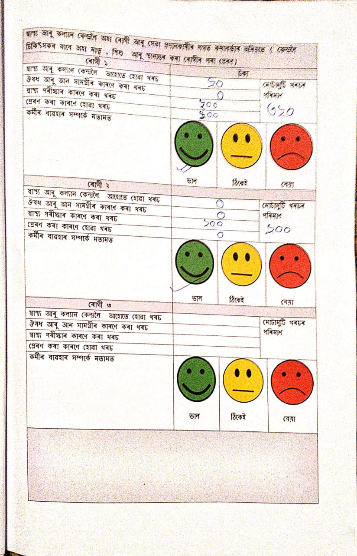
RECORDED RESPONSES
Recorded response on patient feedback:
Patient 1 indicates an expense of Rs. 320 out of pocket expenditure.
Rs. 20/- to reach the H&WC
Rs. 200/- for diagnostics
Rs. 100/- expense for being referred out.
The staff behavior was found satisfactory.

Slide 31
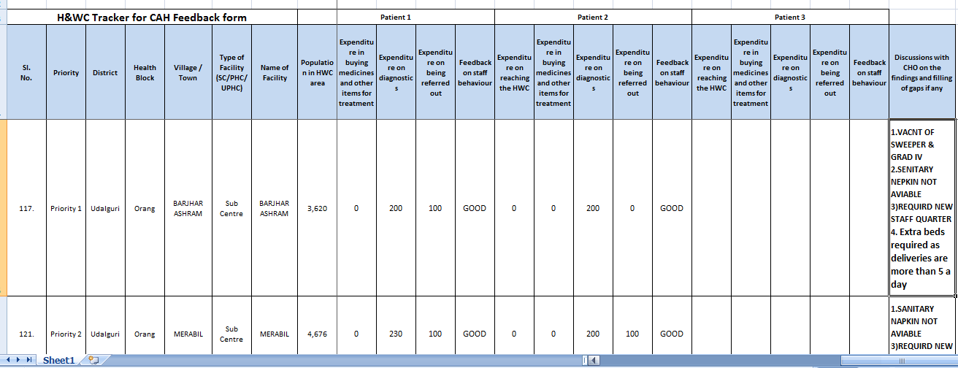
COMPILATION ON TRACKER

Slide 32
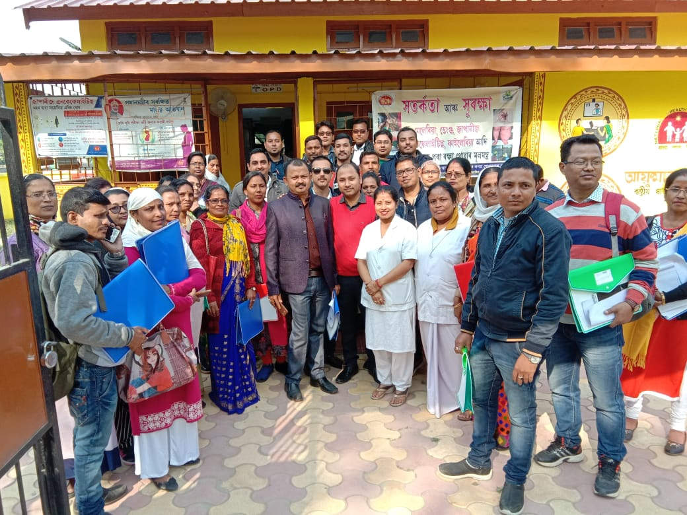
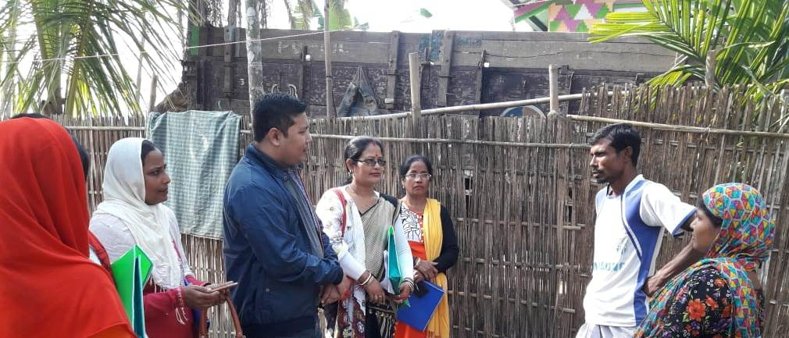
STATE ToT
Exposure visit to H & WC in during the State level ToT on 28th -29th December 2018
Hands on training (during State ToT) by visit to community near H&WC for feedback of services, availability of medicines, Out of pocket expenditure and H&WC staff behavior.

Slide 33
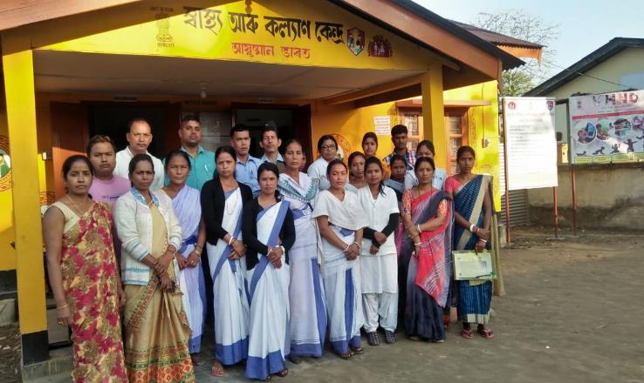
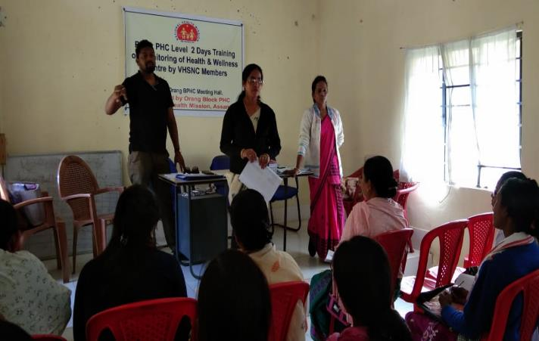
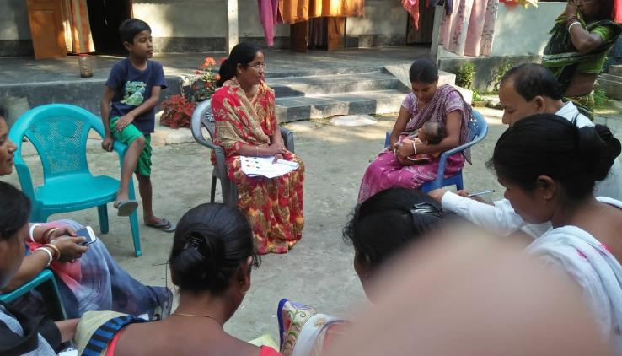
DISTRICT TRAINING TO VHSNC MEMBERS
District Training to VHSNC Members, Exposure visit to H&WC and visit to community by VHSNC members during Training.

Slide 34
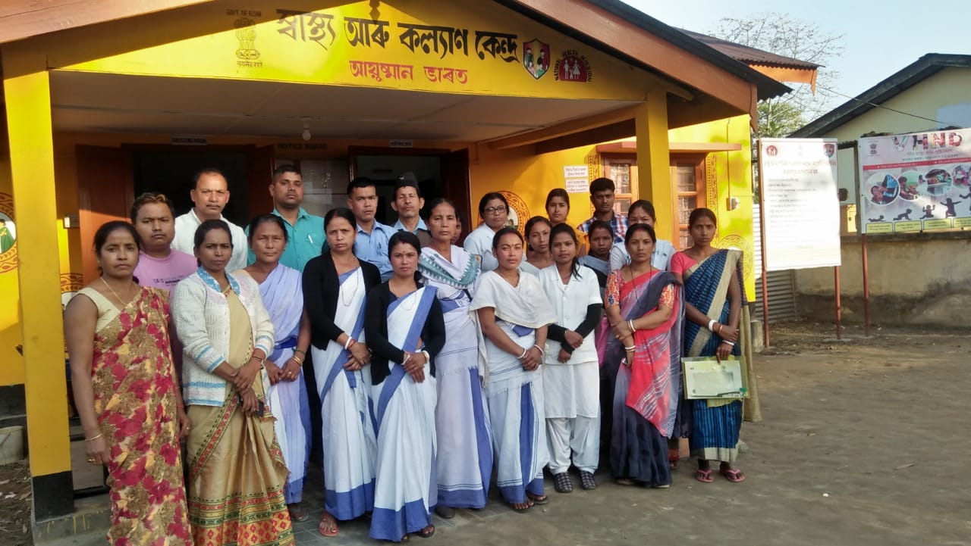
THANK YOU

