Slide 1
National Consultation on Community Processes
Delhi
11/03/2019

Slide 2
Community Processes
Accredited Social Health Activist ( ASHA)
Rogi Kalyan Samitis ( RKS)
Mahila Arogya Samitis ( MAS)

Slide 3
ASHA
Status : Almost 60% of population being covered by ASHAs . 5700 ASHAs in place . Trainings of 85 to 95% ASHAs in ASHA Modules. 50% in NCD Module.
Around 1500 NIOS accredited.
Incentives revised recently . Average incentive around 7000/-
Kits provided .
Challenges : Quality in trainings / Quality in services rendered / ANM and ASHA Synergy / Systemic apathy ( Need for Accountability ) .

Slide 4
Rogi Kalyan Samiti
Status : Formed so far only in hospitals .
Still strggling with the primary health care facilities.
Very little expenditure.
Challenges :
Only hospital RKS in place .
Approved activities for using money.
Patient Satisfaction Survey / NQAS assessment / Referral rate with reasons / Mortality .

Slide 5
Mahila Arogya Samiti
Status : Pilot project 98 MAS formed in eleven district.
Members trained
Bank Accounts opened and funds transferred.
Started functioning.
Challenges : MAS : NGO / Civil Society support required for upscaling -- to form / operationalize / opening of bank accounts / get meaningful outputs and outcomes in a sustained manner .
Health System Accountability / Ownership .

Slide 6
Todapur Eye Camp
Eye check up camp organized for slum dwellers of the catchment areas of Gas Godam Todapur, New Delhi by the Mahila Arogya Samiti (MAS) groups named Mahila shakti & Ujjwalla Mahila Arogya Samiti .
Organized by : The two MAS with Local dispensary support / RP Eye Center team facilitated by the District and State ASHA Units.

Slide 7
Objective of the eye camp:
To create awareness about eye disorders , general eye care, cleanliness, hygiene .
To detect refractive errors .
To detect cataract patients and identify people who needed surgery for removal of cataract .
To provide spectacles to those who needed it .
To facilitate surgery for those who needed it .

Slide 8
Preparation for Eye camp
MAS decided to take it up as an activity .
Co-ordination with AIIMS Team / Local center.
Arrangements of logistics etc.
Suitable place / furniture for beneficiaries registration , for screening / Detailed examination
Line listing of the target beneficiaries and awareness regarding Camp by MAS members through door to door as well as group meetings / banner at key locations etc.

Slide 9
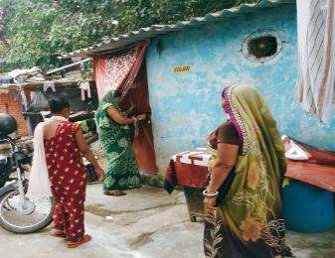
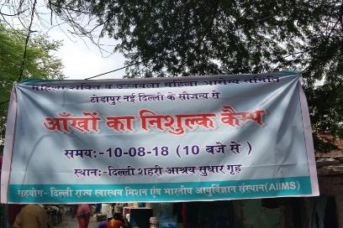
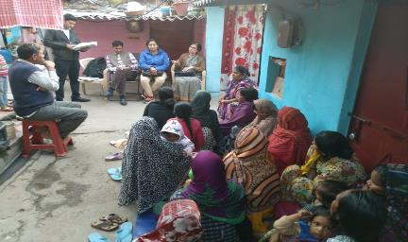
Preparation for the Camp

Slide 10
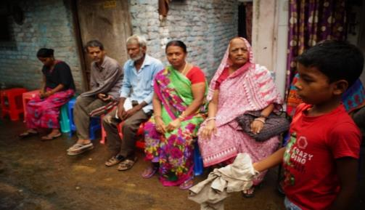
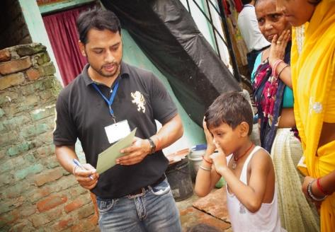
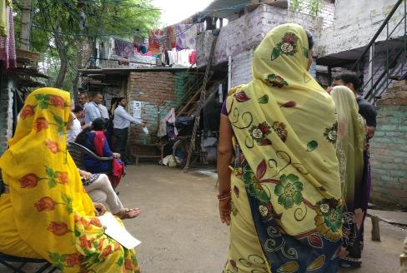
Day of the Camp

Slide 11
Day of the Camp

Slide 12
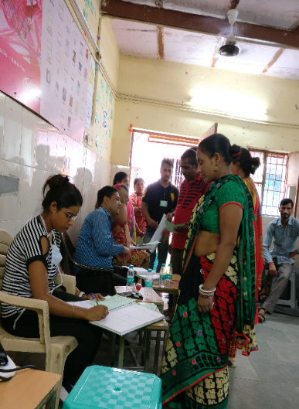
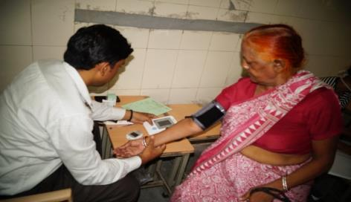
Day of the Camp

Slide 13
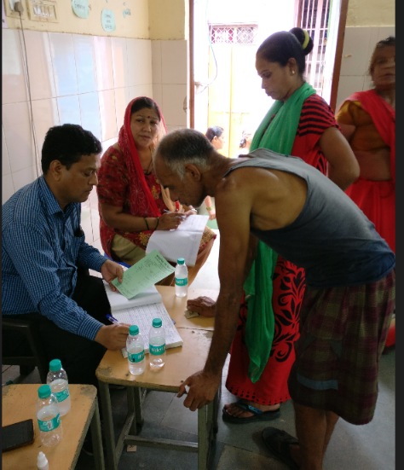
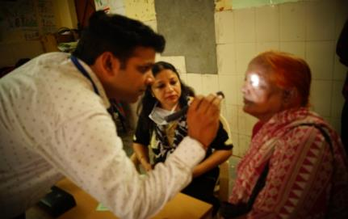
Day of the Camp

Slide 14
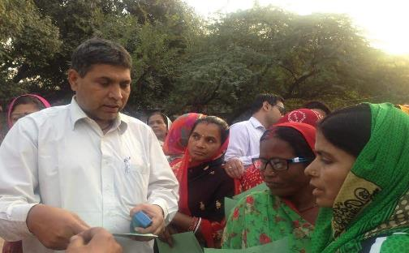
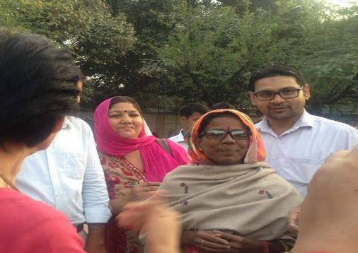
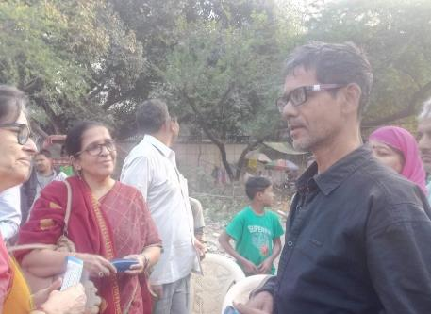
Spectacles

Slide 15
Output / Outcome
1 | Total No of beneficiary screened for eye diseases | 116
2 | No. of patient detected with Cataract | 07
3 | No of patient found with refractive error | 48 ( 37 Unifocal 11 Bifocal)
4 | No. of patient counseled; a). For refractive error b). For cataract surgery | 55 48(37Unifocal /11 Bifocal ) 06
5 | No of patient operated for cataract surgery | 05
6 | No of patients provided spectacles | 48

Slide 16
Lessons
MAS can be an important vehicle for positive health seeking behaviour.
Requires effort for formation and operationalization.
In the long run is the main instrument for implementation of Public health initiatives.
Is a must for sustaining the health gains in a community.

Slide 17
Lessons : Biggest Bottleneck

Slide 18
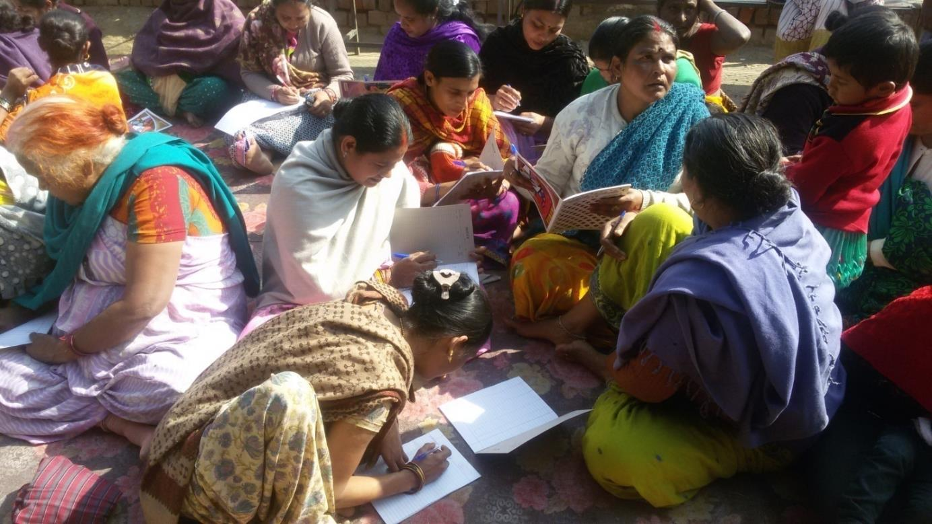
"Never doubt that a small group of thoughtful,
committed citizens can change the world; indeed, it's the only thing that ever has.
- Margaret Mead

