Slide 1
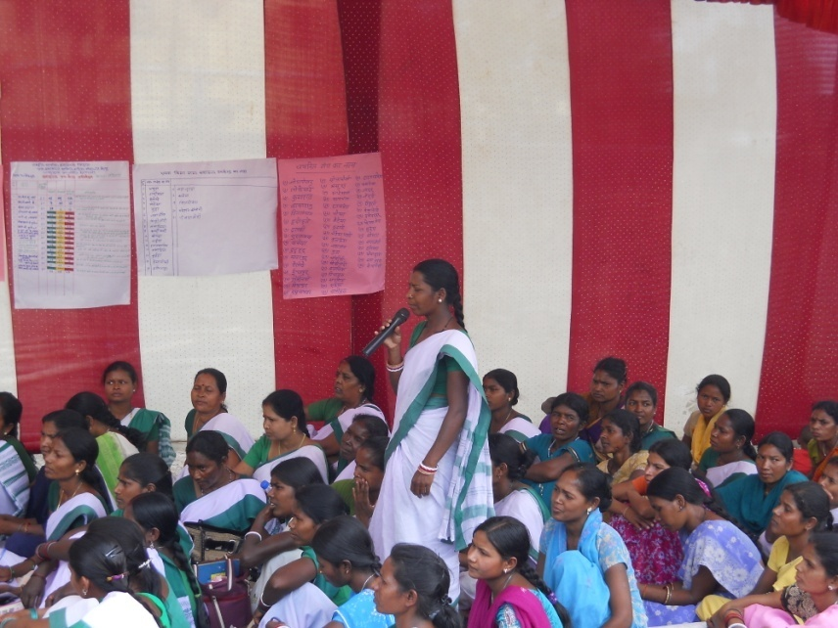
Synergizing with Social Audit Unit for Strengthening Accountability - JHARKHAND
National Consultation on Community Action for Health
New Delhi, March 11 – 12, 2019
Community Mobilization Cell, NHM- Jharkhand

Slide 2
leading from the past to the present
Community Accountability processes were started in FY 2010 – 11 in all districts
Programme being implemented through separate support structures of STT, BTT and Sahiya Saathi
50 villages from each block implemented Community based monitoring in all 24 districts

Slide 3
Community Processes - Support Structure
Dept. of Health & Family Welfare - GOI
NHSRC
Jharkhand Health Mission
VSRC - CM Cell
Cell In-charge – Dept. Director Health services
State Programme Coordinator
Training Coordinator
Admin and Finance Officer
National Trainer Team (NTT)
District Programme Coordinator
State Trainer Team (STT)
VHSNC/PRI
Sahiya Sathi
Block Trainer Team(BTT)
Sahiyya

Slide 4
Processes followed under CBM Intervention
Orientation of stake-holders at state/ district and block
Team comprise of STT/ BTT/ Sahiya Saathi identified and trained on Community based monitoring processes and mechanism
Village report card on important key health indicators prepared
Validation of Report card through Gram Sabha
District and Block Level hearing to sort out issues arising from village level community monitoring
Development of Action taken report

Slide 5
Lesson learnt from CBM…leading for greater prospective….. SAU engagement
Low motivated team members due to lack of department ownership
Actual report generation from the field
Lack of ownership among the government officials regarding public hearing
Incompetent Action Taken report leading to less or no outcome
Officials get sense of revenge for complainants made by the community

Slide 6
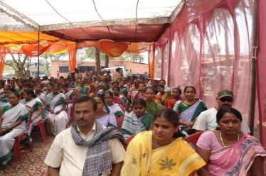
Why Social Audit Unit?

Slide 7
Social Audit Unit - Mandate
Enabling citizen to access relevant information regarding government programme and people right
Linked with two fundamental rights i.e. Right to access to information and the right to public participation
Process to engage beneficiaries, elected representatives and the general public at every stage of the implementation (Planning, implementation, monitoring and evaluation)
Strengthening Gram Sabhas for conducting Social Audit
To undertake audit for verifying records vis-à-vis services provided under entitlements
To ensure that the government programme are being implemented as designed

Slide 8
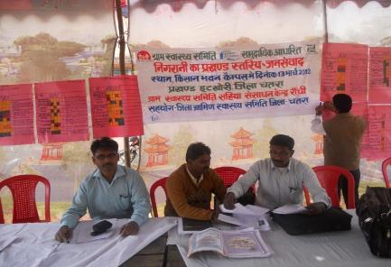
How Social Audit Unit strengthening communization processes?

Slide 9
Complimenting Community Monitoring work through Social Audit processes at district/ block/ villages and ensuring that the entitled health services are being provided to the people as it has been envisaged
Walking together with State Social Audit Unit (RD)
Partnership proposed with NHM Jharkhand for undertaking Social Audit through SAU at four selective panchayats of four selected blocks of Ranchi, Deoghar, W.Singhbhum, Palamu and Hazaribagh district.

Slide 10
Expectation from partnerships
Developing stronger partnership between stakeholders for corrective actions
Finalization of tools for undertaking social audit of health services
Facilitate social audit at Gram panchayats level
Facilitate Jan Samwaad (Public hearing) at District/ block and panchayats
Development and finalization of Action Taken report (ATR) post Jan Samwaad
Data entry, compilation and analysis of report to prepare state level report

Slide 11
Key Process through SAU
Mutual agreement on key processes between NHM and SAU
Adaptation of tools based on health entitlements
Organizing training to resource person/social audit team at state level
Social audit and public hearing of health services at Gram Panchayat level
Preparation for action taken report to further sharing at district level
Facilitate state level public hearing

Slide 12
Health services to be monitored through SAU
At Community level;
General Health services
Maternal Health care services and reach of JSY and JSSK
Adolescent related Health services
Family Planning
Work and Responsibility of ASHA
At facility level;
Services at Health Sub Centre
Services at CHC/PHCs

Slide 13
SAU Approach
Three members team facilitating field works (2 Resource person from Social Audit Unit and one person from NHM (BTT/ STT)
Field work spread over six days of week time at each Panchayat
Day 1 | Day 2 | Day 3 | Day 4 | Day 5 | Day 6
Social Audit as per the checklist |  |  | Data Compilation at Panchayat level | Gram Panchayat level hearing | District level hearing (Report from all blocks and Panchayat are being presented

Slide 14
Expected Outcomes from this partnership
Greater visibility of health programme and People Participants
Committed team at gram panchayat level
Evidence based reporting from field level processes
Presence of all stake holders during public hearing for maximum redressal of issues/ concerns
Action taken report for further follow up
Minimize sense of revenge for complainants arising from field level audit
On time completion of process stronger accountability processes
Strong convergence

Slide 15
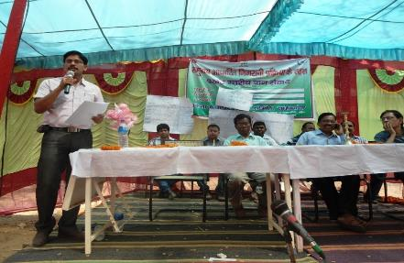
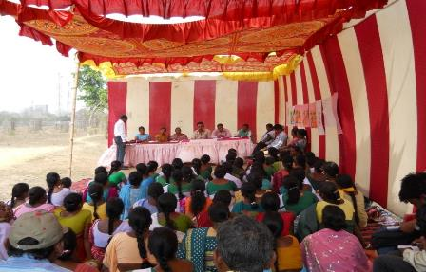
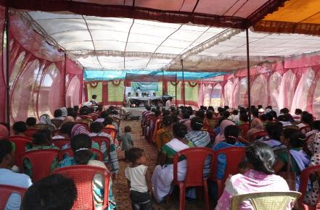

Slide 16
THANK YOU

