Slide 1
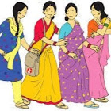
Community Action for Health
Madhya Pradesh
2018-19

Slide 2
Constitution of Mentoring Group for Community Action (MGCA)
Advisory Group of Community Action
(2007)
Mentoring Group of Community Action (MGCA)
(2012)
State ASHA Mentoring Group (2008)
Because majority of Members were same in both groups

Slide 3
STRUCTURE OF MGCA
STATE MGCA | DISTRICT MGCA | BLOCK MGCA
MD NHM (Chairperson), DD, ASHA (Convener) Members: Development Partners Civil Society Organizations ASHA Program Managers Directors & Program Officers (Invitees) | CMHO (chairperson) DCM (Coordinator) Members: DPs members (Invitees) WCD, Education & PRI Representatives 2 ASHA’s (District level Awardees) 2 VHSNC Members 3-5 NGOs representatives who are working in Public Health issues DPs members (Invitees) | BMO (chairperson) BCM (BAM/BPM) (Coordinator) Members: Representative of WCD, Education & PRI 2 ASHA’s (Block level Awardees) 2 VHSNC Members 3 NGOs representatives who are working in Public Health issues DPs members (Invitees)

Slide 4
FUNCTIONS OF MGCA
Advisory role in Policy making for Community Processes
Grievance Redressal of ASHAs
Ensure the availability of quality healthcare services at public health facilities
Address the denial of health care services at facility level
Supportive supervision/ Monitoring in various trainings and capacity building of ASHA programs
Strengthening of VHSNC/GSSGTS (PLA module and VISHWAS campaign)

Slide 5
Intensive Community Monitoring Districts
ICM Districts
Bhind
Chhatarpur
Vidisha
Agar
Hoshangabad
Chhindwara
Betul
Khandwa
Barwani
Alirajpur

Slide 6
Progress 2018-19
Support for Designing ASHA welfare scheme
Induction of New members in State MGCA group
Reconstitution of District and Block MGCA committees
State Level Meetings – 04
Successfully completed State level 2 day Tool orientation workshop
District Level Meetings – 50
Block Level Meetings – 290
(Some meetings are schedules in March 2019)
Regular monthly meetings of ASHA grievance Redressal cell
Visits of State MGCA members in all 10 Intensive districts

Slide 7
ASHA Grievance Redressal Status
STATE LEVEL
Cases recieved | Cases resolved | Cases Pending
21 | 18 | 03
DISTRICT LEVEL
Cases recieved | Cases resolved | Cases Pending
460 | 285 | 175

Slide 8
Extended/Additional Role of MGCA
Training and Capacity building of ASHA
Participatory Learning and Action (PLA)
VISHWAS Campaign
MGCA

Slide 9
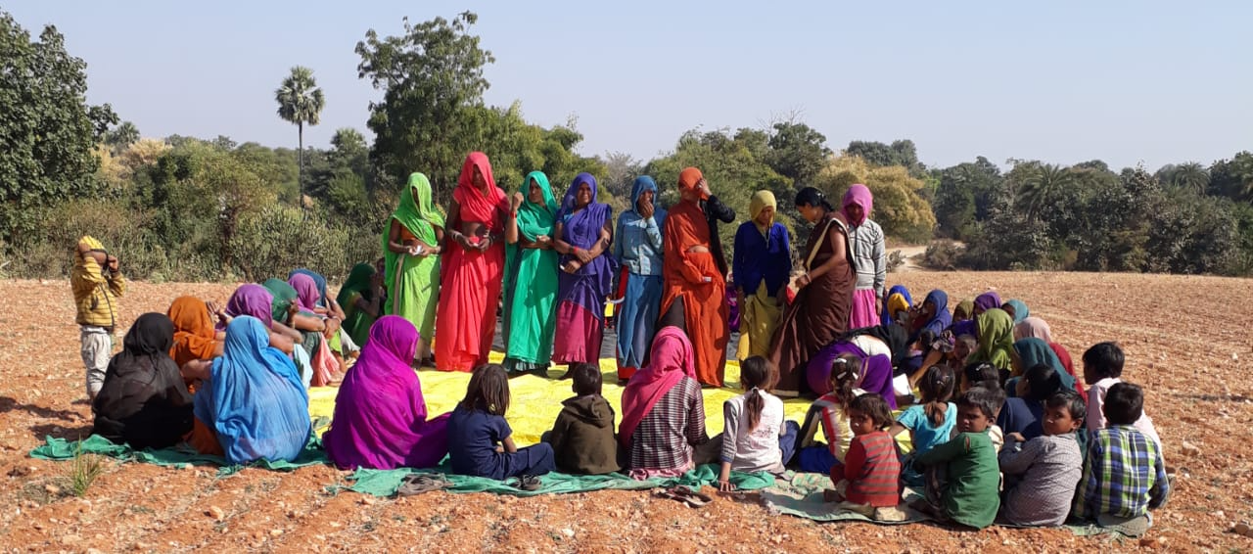
Participatory, Learning and Action

Slide 10
Participatory Learning and Action Program
Phase 1 – 24 blocks of 10 Districts
Phase 2 – 13 blocks of 05 Districts
Phase 3 – 02 blocks each of 07 Districts of phase 1
Phase 4 – Extended program area in 19 blocks of 09 Districts
Total Program area : Districts-24 & Blocks-70
All High priority Districts, aspirational districts and Districts having primitive vulnerable tribal groups (Baiga, Bhariya and Sahariya) are included in the program.

Slide 11
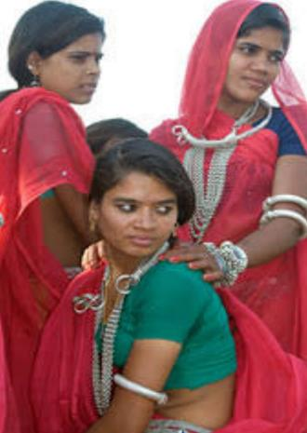
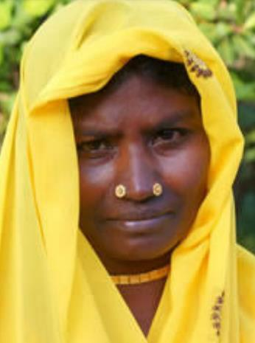
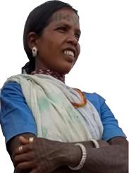
Primitive Tribal Groups
Sahariya
Bhariya
Baiga

Slide 12
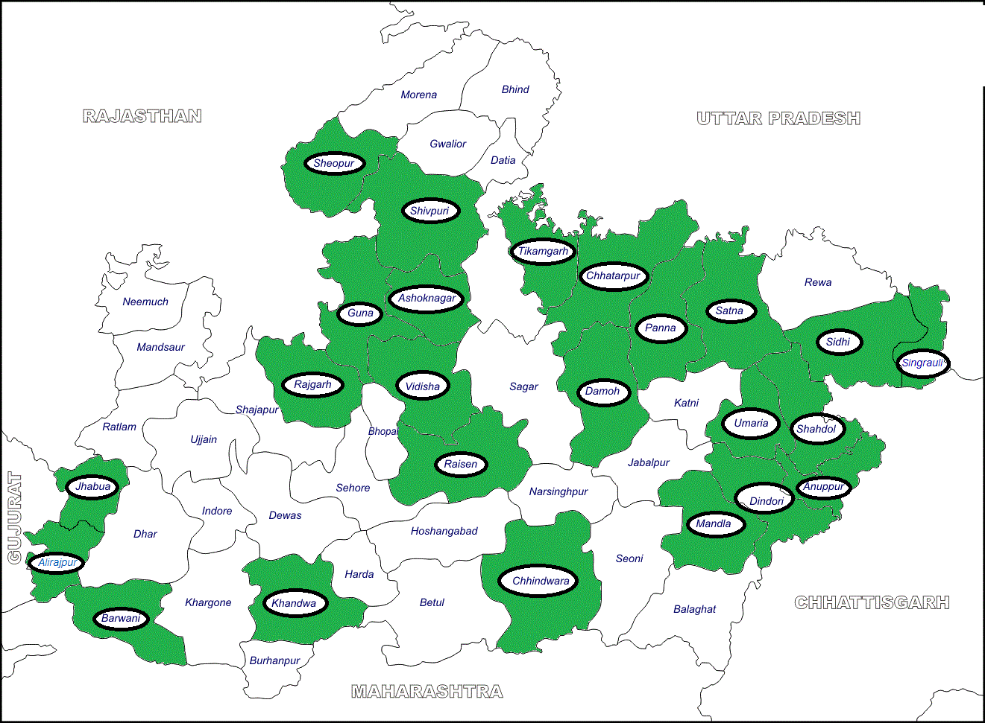
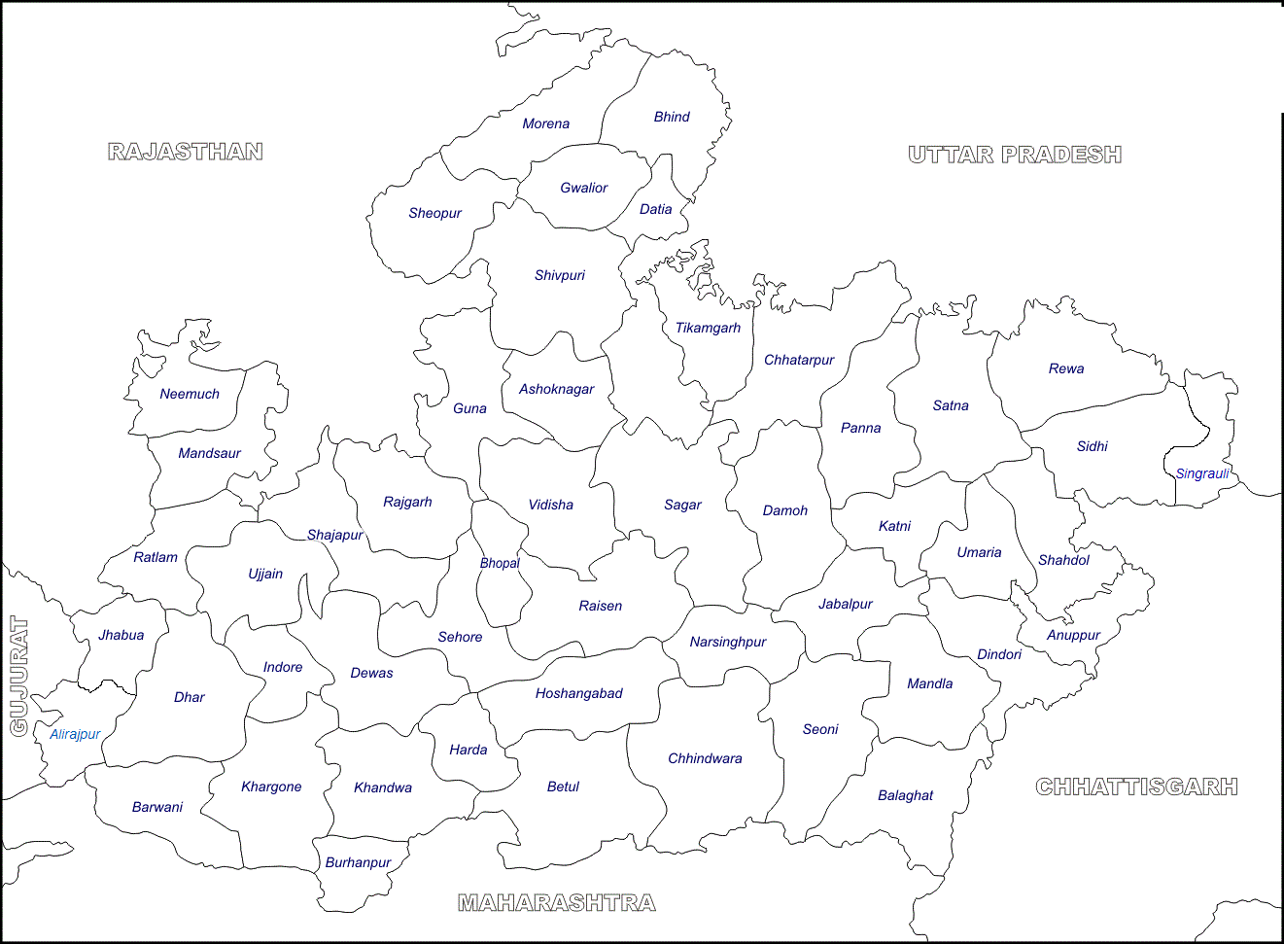
PLA Program Area

Slide 13
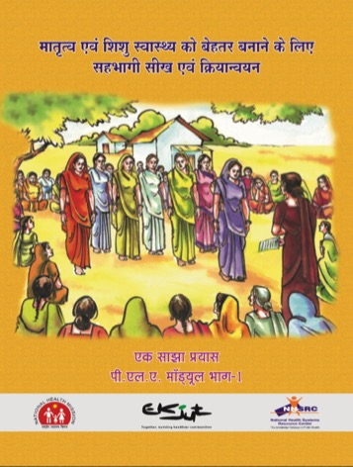
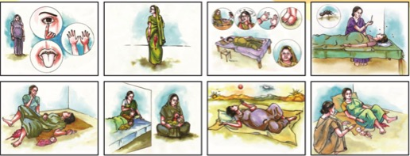
PLA - Round I Manual and Picture Cards

Slide 14
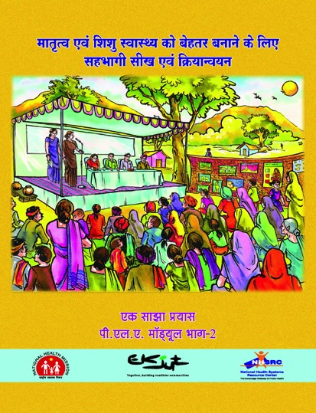
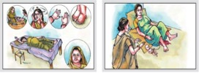
PLA Round-2 module and picture cards

Slide 15
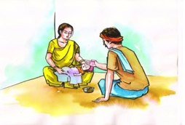
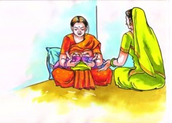
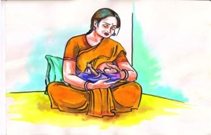
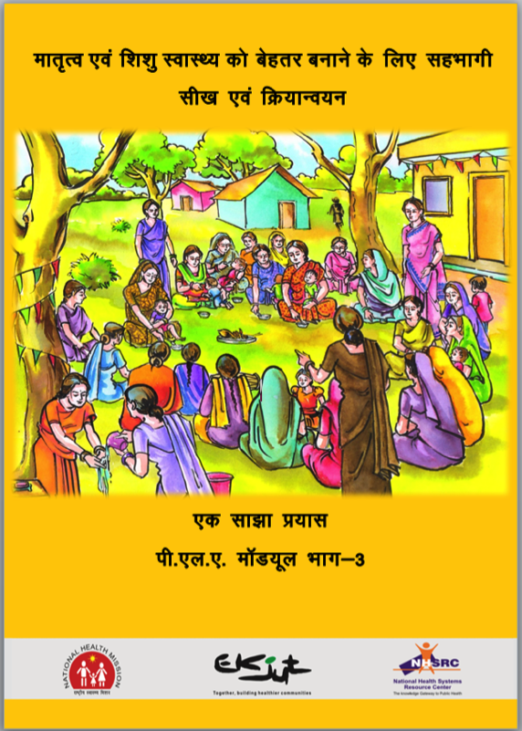
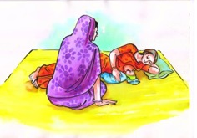
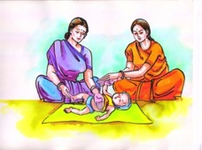
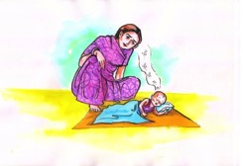
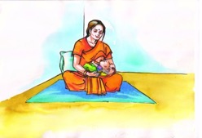
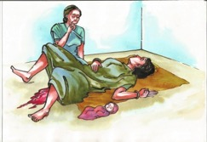
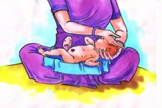
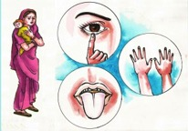
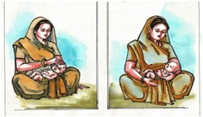
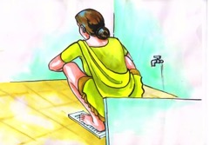
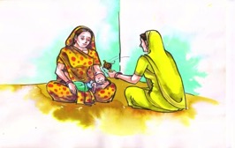
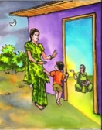
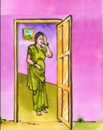
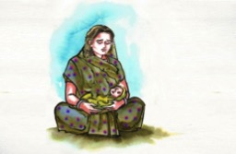
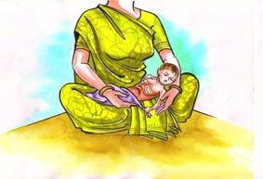
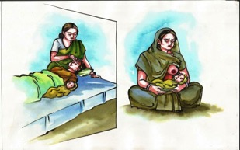
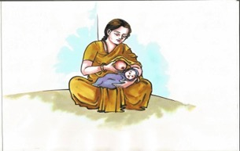
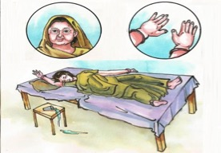
PLA Round-3 module and picture cards

Slide 16
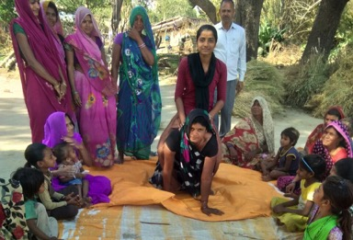
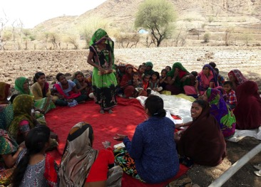
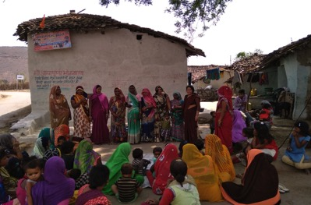
Progress till date…
PLA Round I & II meetings have started happening in villages of 37 blocks of 15 districts
Till now we have completed 35,100 PLA meetings in field with participation of around 8,77,500 women

Slide 17
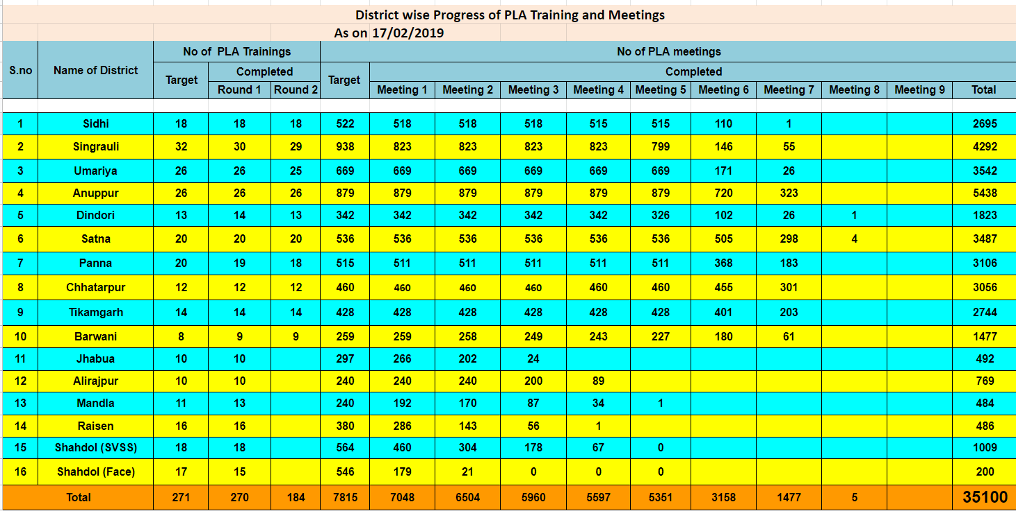
Progress till date…
Weekly PLA trainings and meetings reporting system
About 8,77,500 women participation recorded.

Slide 18
Role of MGCA in PLA program
Right from the beginning of the program, MGCA members were involved in PLA program.
An essential member in NGO selection for implementation at district level.
Involved in all TOTs at state and district level.
Advisory role in Module designing
Monitoring and Supportive supervision at grass root level

Slide 19
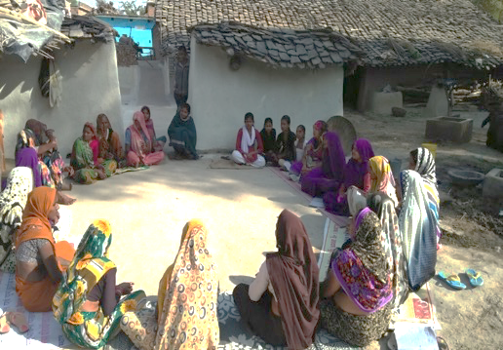
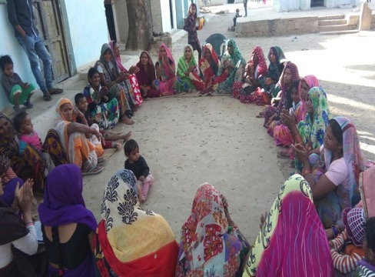
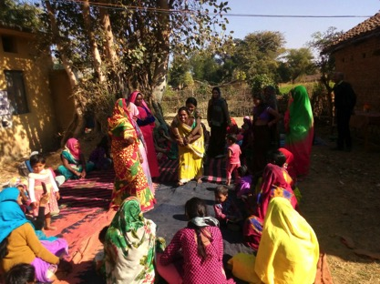
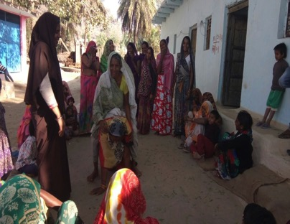
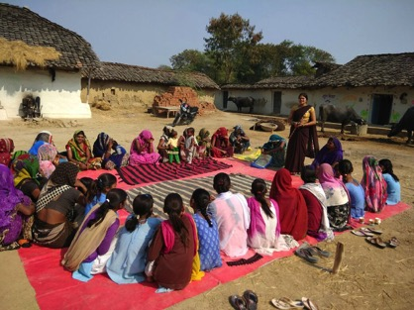
PLA meetingS

Slide 20
VISHWAS (Village based Initiative to Synergise Health, Water and Sanitation)
It helps to strengthen the leadership of VHSNCs/GSSGTS
A collective initiative at community level, for improving Water, Sanitation and Hygiene situation (WASH) and its impact on Health and quality of life.
Strengthen convergent action in integration with various initiatives under Swachh Bharat Mission (SBM).
Capacity building of VHSNCs/GSSGTS Members to carry out 11 monthly activities.
MGCA members are helping as trainers and in monitoring and supportive supervision of Vishwas Campaign.

Slide 21
VISHWAS Campaign – Program area
District | Block | VHSNC | Members | Batches
Betul | Sehra | 163 | 815 | 27
Betul | Bhimpur | 152 | 760 | 25
Betul | Bhensdehi | 138 | 690 | 23
Betul | Shahpur | 112 | 560 | 19
Betul | Athner | 98 | 490 | 16
Betul | Amla | 130 | 650 | 22
Betul | Chicholi | 87 | 435 | 15
Betul | Ghodadongri | 163 | 815 | 27
Hoshangabad | Kesala | 153 | 765 | 26
 |  | Total VHSNC -1196 | Total Members trained - 5980 | Total batches - 200
The VISHWAS campaign was implemented in 02 Tribal districts namely – Betul and Hoshangabad of Madhya Pradesh.
27 district trainers and 02 DCMs were trained in the Vishwas Module.
The 09 tribal blocks were selected in these districts and around 5960 members from 1196 GSSGTS were trained in the VISHWAS module.
Per VHSNC 04 members & 1 ASHA were selected and were trained.
The Campaign will be expanded in 08 aspirational districts in year 2019-20.

Slide 22
Monthly Campaign Days of VISHWAS Campaign

Slide 23
Role of VHSNC/GSSGTS as platform for ‘Community Action'
An important mechanism for participation of stakeholders at community level.
Enable local planning by creating community level dialogue.
Building convergent collective action on social determinants and public services related to health.
Enable communities to take collective action for higher health status and improved quality of life in the village.
MGCA members are having the important role in attaining the above objectives.

Slide 24
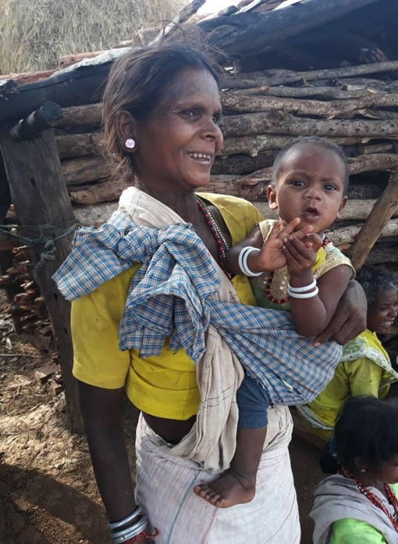
THANKS

