Slide 1
National Consultation on Community Action for Health (CAH)
Advisory Group on Community Action (AGCA)
11TH – 12TH March 2019
Vishwa Yuvak Kendrda, New Delhi
Department of Health & Family Welfare (MCH&FW),
Government of Meghalaya
& Meghalaya Society for Social Audit and Transparency (MSSAT), Social Audit Unit, Meghalaya.

Slide 2
Engagement with State Social Audit Units
Scaling up social audit of health services in Meghalaya

Slide 3
CAH – Meghalaya : Status
Meghalaya is implementing Community Action for Health in
5 Districts,9 Blocks, 27 PHC & 189 villages
Meghalaya initially implemented CAH :
Through the NGOs & Support Structure of NHM.
In 2017-18, implementation was done only by the support structure due to non availability of fund.
On 10th Oct 2017 State got the opportunity to attend the workshop on the Meghalaya Community Participation and Public Service Social Audit Act, 2017– MCP & PPSA.
State Community Action for Health has incorporated with Meghalaya Society for Social Audit and Transparency (MSSAT) for conducting Social Audit in piloted areas in 6 districts, 6 blocks and 18 villages during 2017.
Involvement of MSSAT has been useful in:
providing independent audit of scheme.
bringing out the issues raised from public hearing.
providing a forum for quick resolution on inter department.
For 2019: Community Action for Health is scaling up through MSSAT. (i.e. scaling up in all the villages of each block under the 11 districts.

Slide 4
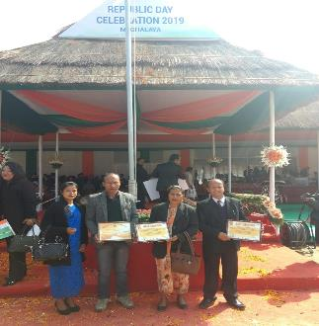
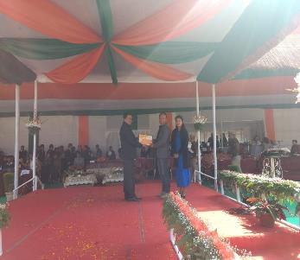
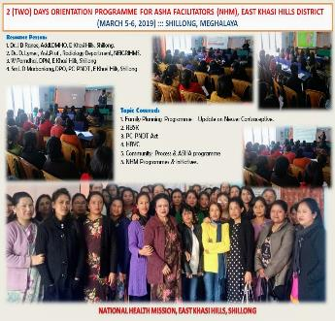
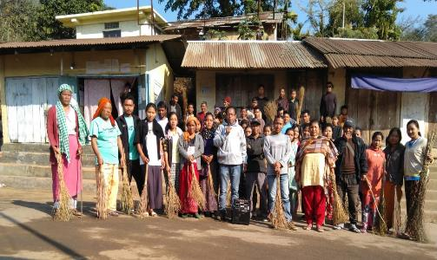
VHSNC activities & Awards -NHM

Slide 5
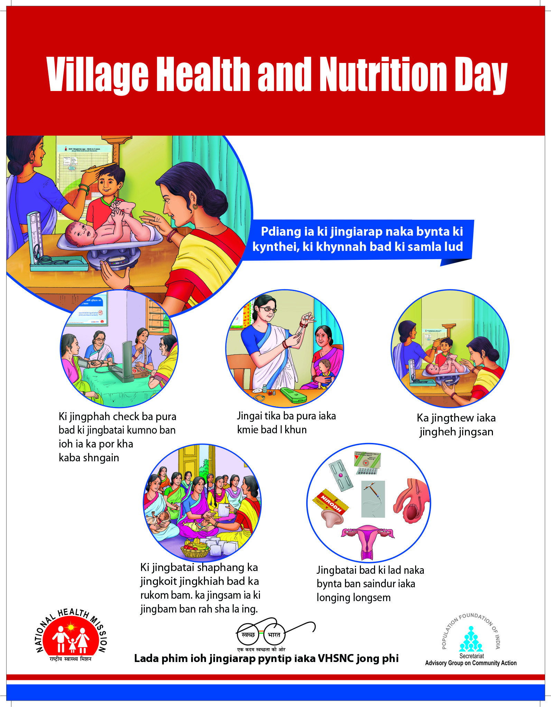
Translated sunboards-nhm

Slide 6
Meghalaya Society for Social Audit and Transparency (MSSAT)
MSSAT was formed on the 14th November 2014 & Registered under the Meghalaya Society Registration Act XII 1860 on the 25th February 2015.
The objectives of the society are to facilitate the conduct of Social Audit of the Works taken up under the central and the state sponsored schemes. At present, the MGNREGA & PMAY- G are being audited in the manner prescribed under relevant Rules, and the capacities of the stakeholders are being built for further strengthening of the Social Audit process.
The MoRD have designate the State Social Audit Unit as the nodal state unit for the facilitation of conduct of social audit of Rural Development Programmes i.e, the MGNREGA, PMAY- G & NSAP among others
The SAU have been identified as the technical secretariat for the implementation of the “Meghalaya Community Participation and Public Services Social Audit Act, 2017”.
For 2019-20, the SAU shall also facilitate the conduct of social audits for schemes /programmes other than the RD Programmes, for Health Programmes , MDM, Border Area Development Programmes as approved by the Governing Body of the SAU.

Slide 7
History
History of the social audit of Health Programmes and Health Services in Meghalaya in Meghalaya- started in the lines of the Social Audit Rules for MGNREGA and Under the “Meghalaya Community Participation and Public Services Social Audit Act, 2017”
Notification :
The Meghalaya Community Participation and Public Services Social Audit Act, 2017 was notified and enacted by the Government of Meghalaya on the 4th April 2017 and enforced on the 17th November 2017.
Schedule – 1 of the MCP&PSSA Act : B. Health.
(a) Health services including immunization.
(b) Services rendered by the nearest Sub Centre/PHC/ CHC.

Slide 8
Pilot Social Audits
Pilot social audits was conducted w.e.f 17th – 24th November 2017 in 18 villages under 6 districts.
12 (twelve) Villages under Khasi & Jaintia region
6 (six) villages under Garo region
Villages having more than 200 HHs(households)
Schemes covered- SSA & MDM, ICDS, MGNREGA, PMAY-G, NSAP, Health Services available at the PHC& Sub Centres & CAHP, BADP, PWD, PHE&SBM, Forest & Env, PDS, NPSA(Agri) & MIDH ( Hort) & Skilling & Employment (Labour).

Slide 9
Pilot social audits : 17th November 2017- 23rd November 2017.
Health Department : Scheme – Janani Suraksha Yojana, Services available at the PHC, CHC, SC Nos. of Villages covered : 18 [eigthteen] nos.
Nos. of PHCs covered : 8 (eight) nos. [ Kynrud, Pomlum, Diwon, Laitlyngkot, Dawki, Jarain, Dobu, Kharkutta].
Nos. of Community Health Centre (CHCs) : 1(one) no. [Nongkhlaw].
Nos. of Sub Centres covered : 7 (seven) nos. [ 12- Mer, Koksi Nengsat, Darrang, Mawkma, Chibongnga, Baridua, Chotcholjia].
Nos. of VHNSCs covered : 18 [eighteen] nos.
Nos. of ASHA covered : 16 [ seventeen] nos.

Slide 10
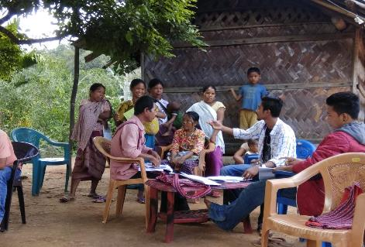
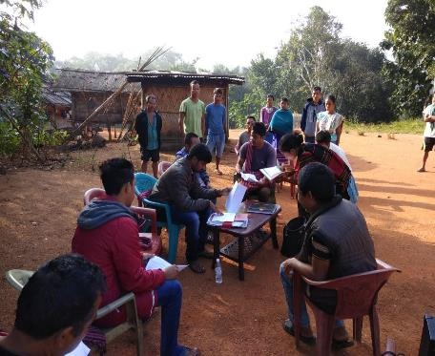
Community, Locality Group Discussion, Interaction & Verification with beneficiaries

Slide 11
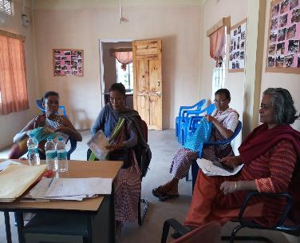
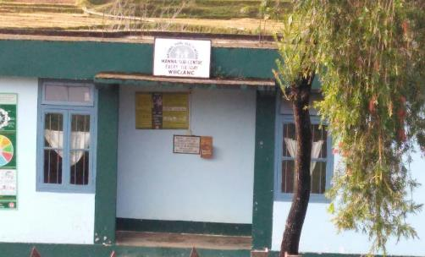
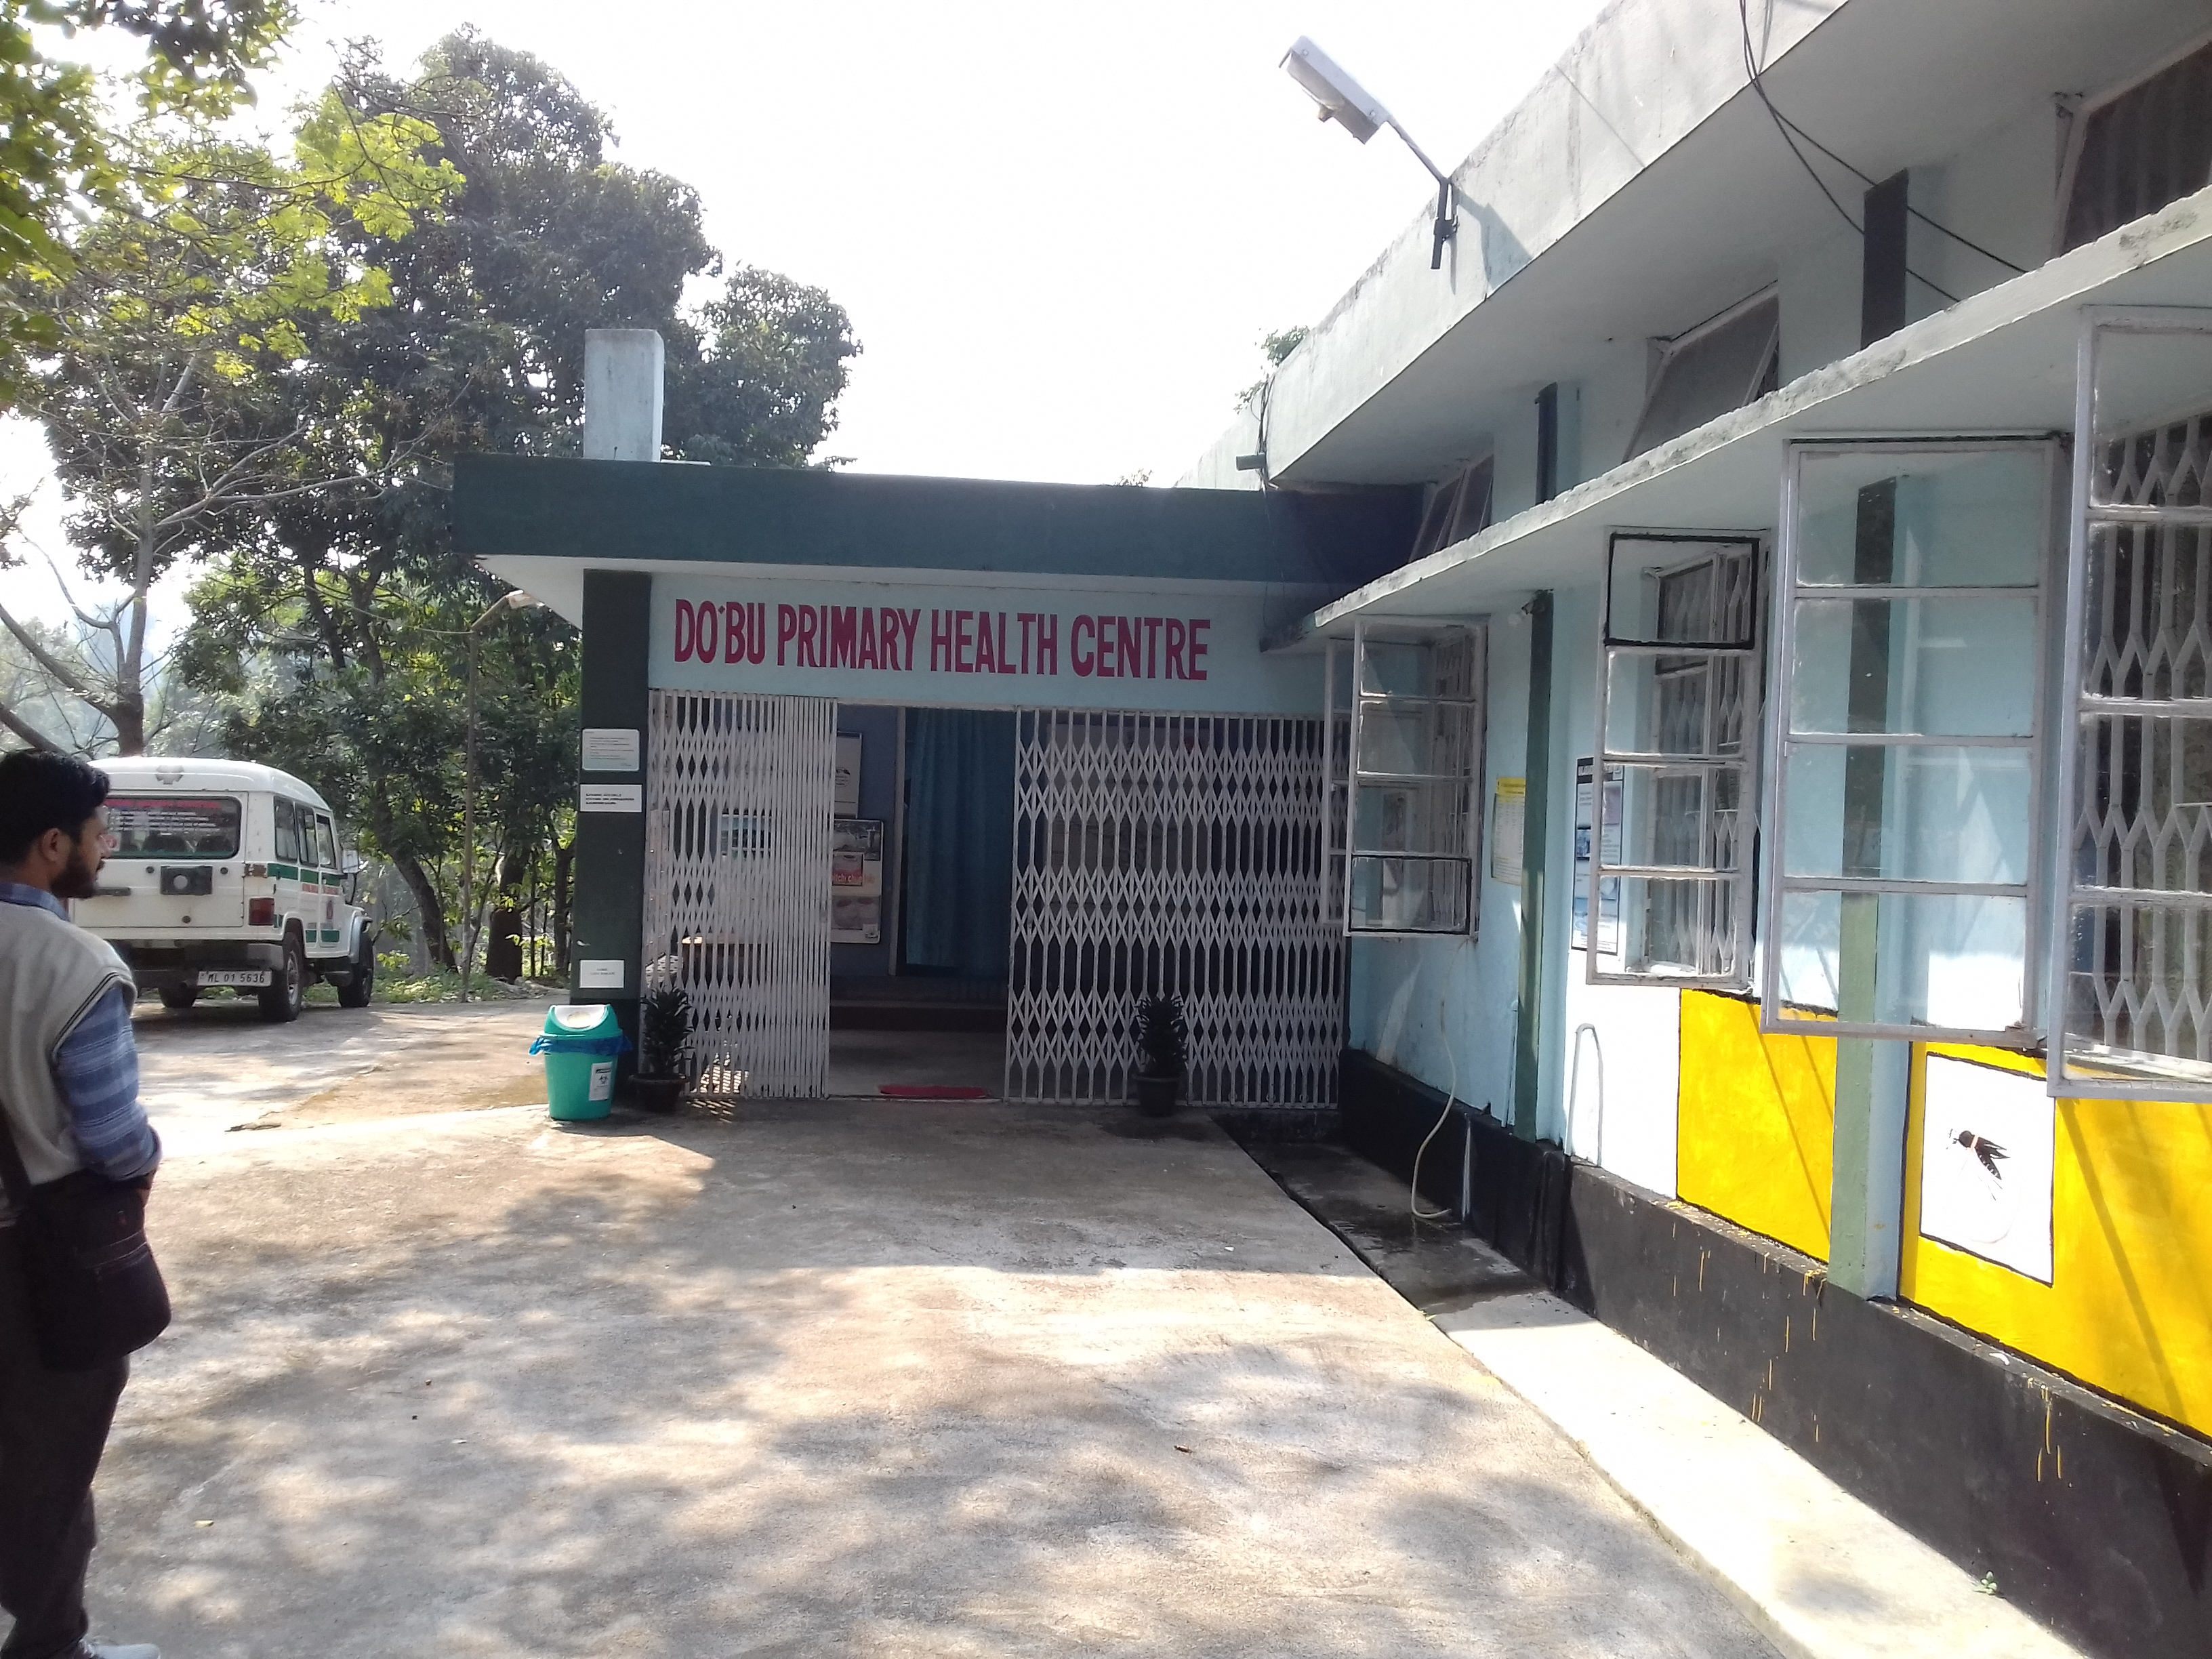
Visits and Verification at the Sub Centre

Slide 12
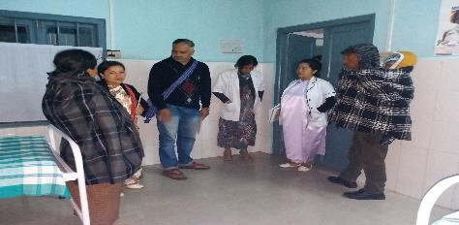
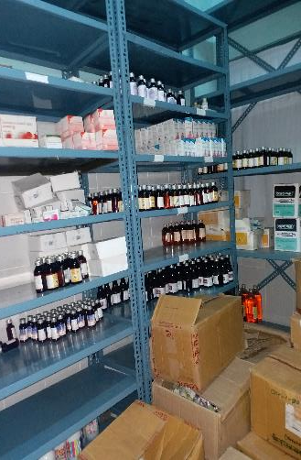
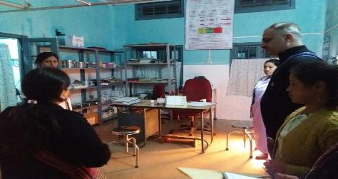
Visits and verification at the PHC

Slide 13
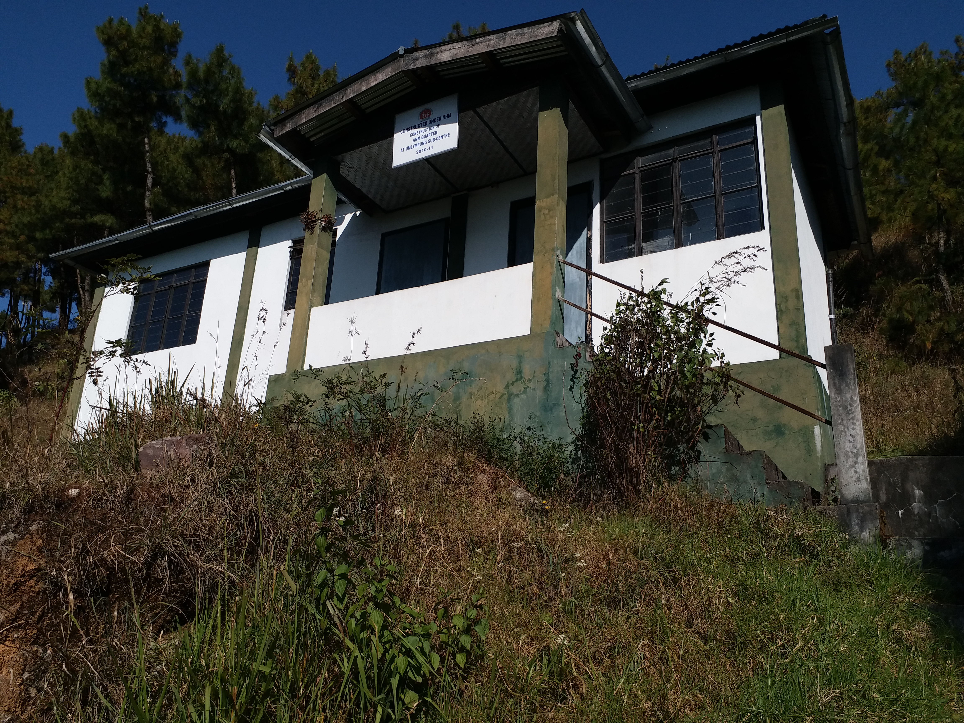
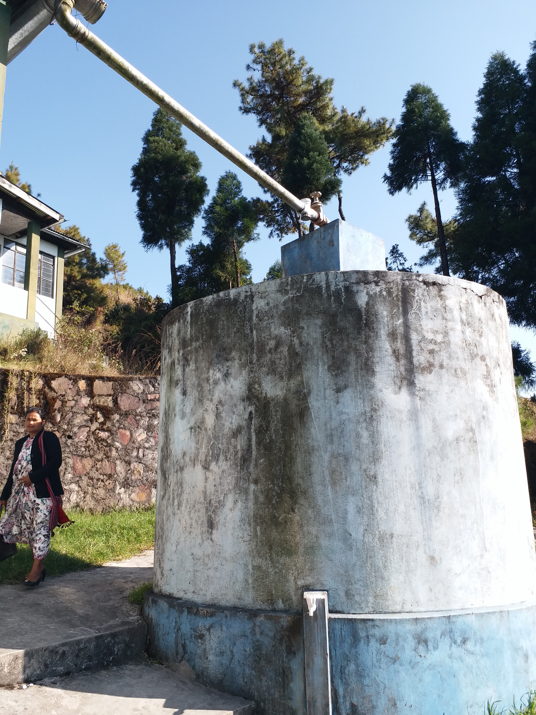
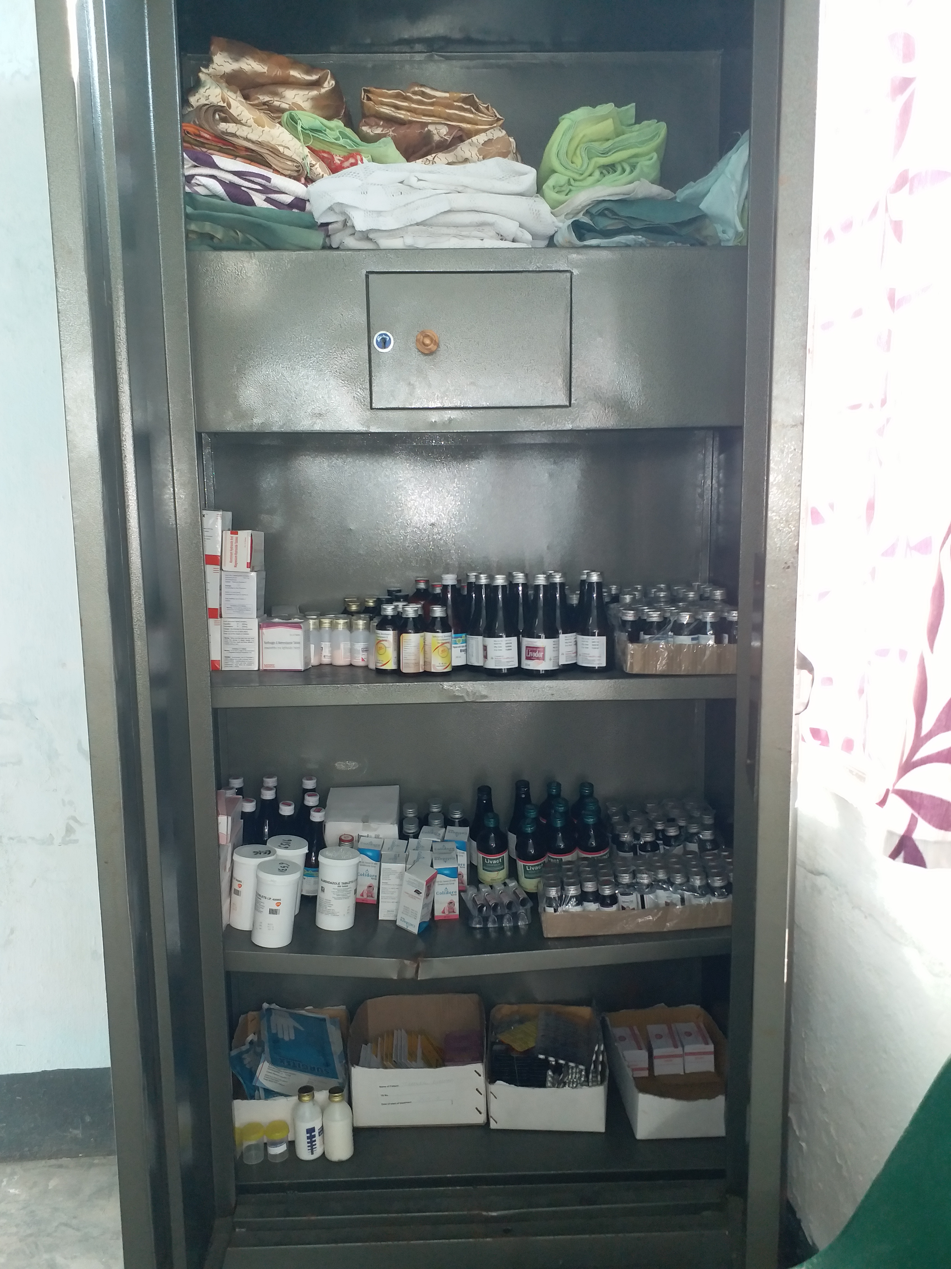
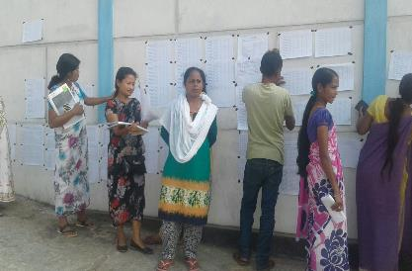
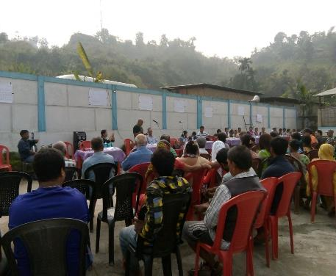
SOCIAL AUDIT PUBLIC HEARING- Proactive Disclosure of Information, Presentation of Social Action Findings, Action Taken, Recommendations & Suggestions, Help Desk

Slide 14
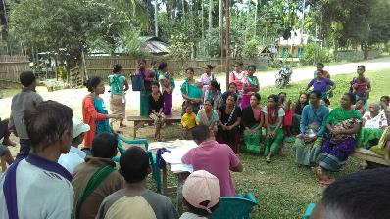
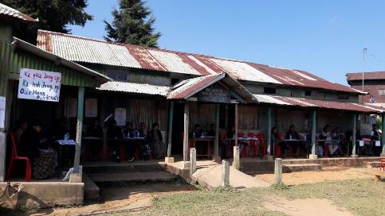
SOCIAL AUDIT PUBLIC HEARING- Proactive Disclosure of Information, Presentation of Social Action Findings, Action Taken, Recommendations & Suggestions, Help Desk

Slide 15
Social Audit Findings & Action Taken Reports
Sl. No. | Social Audit Findings | Action Taken Reports
1. | VHSNC meeting not held regularly in 4(four) villages namely: 1. Kynrud, 2. 12 Mer, 3. Jarain , 4. Dobu Achengbok. | DMHO instructed MO to ensure VHSNC are held regularly.
2. | No training given to VHSNC in 3 (three) villages namely: 1. Jarain, 2. Dobu Achengbok, 3. Megam Akong. | Dobu Anchengbok- Training given through ASHA at the PHC Megam Akong :DHMO instructed MO to provide training.
3. | No medical kits for emergencies as reported in Kynrud PHC | Dept. instructed that all ASHA kits has to be replenished from the PHC.

Slide 16
Social Audit Findings & Action Taken Reports.. Contd..
Sl. No. | Social Audit Findings | Action Taken Reports
4. | Non functioning of medical equipments in 3 (three) PHC/SC namely: 1. Diwon PHC [incubator in pediatrics and refrigerator for immunization], 2. Khanapara - Sterizer ( Autoclave) machine in Baridua Sub Centre), 3. Megam Akong - Chibongga Sub Centre - Blood Pressure instrument is not functioning, replacement required for Steriliser (Autoclave) and Deliver Disposal Kit (DD Kit)]. | Diwon PHC: The radiant warmer and ILR have been replaced. Baridua SC: Matters to be look into by the dept. Chibongnga SC: HO assure within Nov’ 2017 equipment's shall be purchased /replaced.

Slide 17
Social Audit Findings & Action Taken Reports. Contd…
Sl. No. | Social Audit Findings | Action Taken Reports
5. | Shortage of medicine reported from 8 (eight) villages namely: 1. 12 Mer (Pomlum PHC), 2. Iewshillong (Laitlyngkot PHC), 3. Mawkma SC, 4. Bakur (Dawki PHC), 5. Darrang SC, 6. Jarain PHC, 7. Mawsmai Jorabad (Baridua SC) , 8. Koksi Nengsat SC. | Dawki PHC : DHO asked to supply medicine within a week. Darrang PHC, Baridua SC (received only half of the indent) : Matters to be look into by the State dept. Jarain PHC:DMHQ informed matter shall be taken to higher authorities. Pomlum PHC , Koksi Nengsat CHC: Department informed medicine supplied as per indent as approved from GoI. Laitlyngkot PHC, Mawkma SC: medicine received as per indent.
6. | 9 Beneficiaries not getting the JSY as reported from 2 (two) villages namely: 1. Iewshillong , 2. Kynrud. | Iew Shyllong: Services unavailable due to non follow of norms. Kynrud :JSY beneficiaries instructed to provide documents for receive of the JSY.

Slide 18
Social Audit Findings & Action Taken Reports
Sl. No. | Social Audit Findings | Action Taken Reports
7. | JSY not known to the community in Mawnai village | DHMO instructed MO to give awarness
8. | No proper electrification/ electricity reported in two Sub- Centers in 3 villages namely: 1. Mawkma SC , 2. Koksi Nengsat SC . | Koksi Nengsat: SC to deposit money in MeECL. Mawkma SC: Matters taken to MeECL dept.(power).
9. | Staff attendance not maintained for Pomlum PHC as reported from villagers of 12 Mer village (SC in 12 Mer village) | 12 Mer: Attendance henceforth signed as duly checked by MO.

Slide 19
Social Audit Findings & Action Taken Reports- contd..
Sl. No. | Social Audit Findings | Action Taken Reports
10. | (a) No training to ASHA in 5 (five) villages namely: 1. Mawnai, 2.12 Mer 3. Mawsmai Jorabad, 4. Dobu Bazar , 5. Dobu Achengbok (b) ASHA not appointed – 2 (two) villages namely: 1. Bakur, 2. Khanapara. | (A)Bakur: Instructions given to ASHA to maintain proper record. 12 Mer SC: ASHA oriented and trained during monthly meetings at the PHC. Dobu Anchengbok: ASHA appointed without approval sanction till date even after informed to the State through PIP. Training shall be provided. Dobu Bazar (Cherasugittim) : VHSNC shall be recognized and shall be provided training from dept. Mawnai : Training shall be provided within one month. Mawsmai Jorabad: training shall be provided. (B). Bakur : Instructions for maintenance of proper records ; Khanapara: selection of ASHA under process.

Slide 20
Social Audit Findings & Action Taken Reports- contd..
Sl. No. | Social Audit Findings | Action Taken Reports
11. | No water Supply/insufficient water supply in 3 (three) SC as reported from three villages namely: 1. 12 Mer SC , 2. Darrang SC, 3. Koksi Nengsat SC. | Within two days after the social audit public hearing the PHE dept. supplied water to 12 Mer SC. Darrang SC: Water supply shall be provided within 7 (seven) days Koksi Nengsat : PHE dept to follow up.
12. | Health Sub Centre always remain closed as reported in 12- mer Village.
13. | Records not maintaining properly in the VHNSC in Jarain village. | No.ATR
14. | Delay payment to the ASHA as reported in Iewshillong village. | MO responded ASHA payment is paid as incentive based on performance
15. | No dental care service at the PHC as reported in Iewshillong Village (laitlyngkot PHC). | Equipment's not receive form State dept.
16. | Shortage /Absence of staffs at the PHC in 2 villages namely: 1. Jarain PHC, 2. Diwon PHC. | Jarain: Dept clarified that there are 2 doctors [1 MBBS & 1 AYUSH]. Diwon PHC: Matters taken up to higher authority.

Slide 21
Social Audit Gram Sabha and Departmental Help Desk
During the social audit meeting/social audit gram sabha all departments had set up help desk to look into the grievances of the Public.
The help desk provide a flat form to the community, the beneficiaries and the affected person/persons to seek grievance redressal in the form or applications / complaints.

Slide 22
Based on the evidence thrown up by the pilot social audits, on the occasion of the National Convention the Government announced a series of policy reforms.
Health Department : JSY - The Government will ensure issuing of JSY benefit through DBT to all the eligible mothers immediately after the delivery at the respective institution.
Funds : Every Department will apportion 0.25% of its Annual Budget to financing social audit, grievance redress and mandatory disclosures .

Slide 23
Draft Rules, Social Audit Reports & ATR
A copy of the Draft Rules under Meghalaya Community Participation and Public Services Social Audit Rules is available at http://megpied.gov.in/dep_not/Social_audit.pdf
Social Audit Report & Action Taken Reports : Observations, Summary and Action Taken Reports of the Pilot Social Audit reports is also available at the website of the society, @ mssat.nic.in

Slide 24
Social Audits – Health
1. FRAMEWORK for IMPLEMENTATION, National Health Mission, Ministry of Health and Family Welfare, Government of India, 2012-2017.
2.3 Guiding Principles - 2.3.15: Establish an accountability and governance Framework that would include social audits through people’s bodies, community based monitoring and an effective mechanism of concurrent evaluation.
2.4 Goals, Outcomes and Strategies - 2.4.2.24: ….Mechanisms for accountability shall range from participatory community processes like Jan Sunwais/Samwads, Social Audit through Gram Sabhas to professional independent concurrent evaluation.
5.14 Governance and Accountability Framework : 5.14.6…. community oversight such as social audit should be encouraged.
Page 50 Road Map For Priority Action In States: Sl. No.14. Strategic Areas : Community Processes and the Issues That Need to be Addressed : social audit;

Slide 25
Social Audits – Health
2. Guidelines for Community Processes, 2014, NHM: 2.3.1(2.f):
& 3.Handbook for members of Village Health Sanitation and Nutrition Committee : (2.h)
ASHA acts as the member secretary and convener of the committee Also, work with Chairperson for the social of the activities and expenditures
4.Guidelines for Department o f Family Welfare Supported NGO Schemes- NGO Division Department of Family Welfare Ministry of Health and Family Welfare :
3.2.I. Detailed Guidelines for RCH Components : Maternal and Child Health : Activities : Strategic Intervention 5: Safe motherhood and child survival - social audit of maternal and infant deaths and getting these issues discussed in Panchayat meetings
5.Framework for developing health insurance programmes - Some suggestions for States , Ministry of Health & Family Welfare , Government of India New Delhi : Use social audits

Slide 26
Social Audits – Health
Health Management information System
Help Line
Mandatory and Proactive disclosures of all relevant information

Slide 27
Collaboration between health department and the SAU- Meghalaya Initiative. Contd
The experience during the Pilot Social Audit under the MCPPSSA Act 2017 which was held on the 17th – 23rd November 2017 in 18 (eighteen) villages have had an impact to the community and all the stakeholders as a whole who are part and parcel in the implementation of the schemes and services rendered.
The State Health Department felt the need for social audit and have decide to collaborate with the SAU for social audits.
During 2019-20 the SAU shall facilitate the conduct of social audits for all schemes and services including community action for health rendered for the financial year 18-19 in a total of 2161nos. of villages [ nos. of villages in 948 Khasi Jaintia Region & 1213 nos. of villages in Garo regions.

Slide 28
Collaboration between health department and the SAU- Meghalaya Initiative
The Social Audit shall kicks start across these selected villages along with social audits of other schemes MGNREGA,PMAY- G, NSAP, BAD ( in all villages falling under the border areas village list , MDM (in two districts) w.e.f May 2019.
The Social Audit Calender shall be fix and schedules in line with the social audit calender for RD Programmes.
The Social Audit Process shall include all steps of social audits , i.e the Awareness Generation, Sensitization, Document, Site & Door to Door (Individual Verification), and the Social Audit Meeting and the Social Audit Public Hearing.
The Social Audit Meeting at the Village level and the Social Audit Public Hearing at the Block Level shall be a Forum whereby all stakeholders, i.e the beneficiaries , the VHNSC functionaries , the nodal department shall be present for hearing of the presentation of the social audit findings. Actions /Recommendations/Suggestions shall be taken during the Social Audit Meeting & Social Audit Public Hearing.

Slide 29
Way forward
Role of the Implementing Agencies/Institutions:
Awareness & Capacity building for the VHSNC, and staffs in charge of implementation of the programmes/schemes/ services at all levels- SCs, CHCs, PHCs, Hospitals, Health Institutions.
Awareness to the Villages and the General Public as a whole.
Awareness in the form of meetings, trainings, workshops, at all levels, Pamphlets, Brochures, Media
Pro Active disclosure and provision of all records and documents of the Information on the schemes/programmes implemented and services rendered at all level.
MIS Portal for uploading of social audit reports & action taken reports.
Time Bound for all Actions Taken and Time Bound for all Grievance Redressed towards each issues / problems as reported as per the social audit findings
Mandatory Disclosure of all SOCIAL AUDIT REPORTS and ACTION TAKEN REPORTS.

Slide 30
THANK YOU

